Slide 1
Unit 6 Database Design and
the E-R Model

Slide 2
本課程講授內容
PART I: 入門與導論
Overview
DB2系統及SQL語言
闡述關連式資料模型(The Relational Model)
階層式資料模型(The Hierarchical Model)簡介
網狀式資料模型(The Network Model)簡介
PART II: 資料庫設計 (Database Design)
資料庫問題分析與 E-R Model
資料庫的表格正規化
設計介面增刪查改資料庫
PART III: 進階探討
快速存取方法(Access Methods)
資料庫回復(Database Recovery)
協同控制(Concurrency Control)
資料安全與資料正確(Security and Integrity)
查詢最佳化(Query Optimization)
分散式資料庫系統(Distributed Database)

Slide 3
PART II: 資料庫設計 (Database Design)
資料庫問題分析與架構規劃:
若有一大量資料想利用DBMS建資料庫來管理。第一步要分析問題，找到使用者需求
實體-關係模型(Entity-Relationship Model,簡稱E-R Model)是一套資料庫的設計工具。我們可以利用E-R Model分析資料庫問題。它可以把真實世界中複雜的問題中的事物和關係轉化為資料庫中的資料架構
由於利用實體-關係模型設計資料庫時, 並不會牽涉到資料庫的操作、儲存方式等複雜的電腦運作。所以,我們會把心力放在需求分析去規劃想要的資料庫，並以實體-關係圖(E-R Diagram)來呈現
資料庫的表格正規化:
實體-關係圖很容易轉化為表格(Tables)，而資料庫就是由許多表格(tables)組成的
這些表格要正規化(Normalization)才能避免將來操作時的異常現象發生
設計介面增刪查改資料庫:
如何方便、又有效率的管理存取資料庫是使用者最關心的二個要素
良好的介面設計，可以讓使用者方便的查詢、方便的新增、方便的刪除、方便的修改的處理資料庫

Slide 4
Contents of PART II: 資料庫設計
Unit 6 Database Design and the E-R Model
Unit 7 Normalization (表格正規化)
Unit 8 User Interfaces (使用者介面)
Unit 9 實作範例一
Unit 10 實作範例二
----------------------------------------------------
References:
1. C. J. Date, An Introduction to Database Systems, 8th edition, Addison-Wesley, 2004.
2. A. Silberschatz, etc., Database System Concepts, 5th edition, McGraw Hill, 2006.
3. J. D. Ullman and J. Widom, A First Course in Database Systems, 3rd edition, Prentice Hall, 2007.
4. Cited papers (講義中提到之參考文獻)

Slide 5
EX.part2: Term Project
Design and implementation an useful, complete, and “real” database system.
Steps:
Problem Description
System Analysis and Draw the E-R Diagram
Reduction E-R Model to Relational Tables
Design logical database, check Normal Forms
Design some Queries to access your database
Design user interface, and more
Design and implementation of your database system as “complete and real” as possible.
Due:
Demo and
A Comprehensive Report

Slide 6
EX.part2.1: Problem and E-R Diagram
Problem Description
封面: 題目、組員
題目描述
Take any data you are familiar with. (from your work or ?)
System Analysis and Draw the E-R Diagram
系統分析與設計: using E-R Diagram
By using the E-R model to analysis and describe your data
Using any tools (e.g. Visio), and draw an E-R diagram
You can choose any “real system” as you like, for example:
A small Library System
Accounting System
…
A Banking Enterprise

Slide 7
EX.part2.2: Tables and SQL
Reduction E-R Model to Relational Tables
Refer to UNIT 6, Sec. 7
Transfer your E-R model to Tables
Check each Table to see if it is a
1NF,
2NF,
3NF
Design Query
Using SQL to define and create Tables
Design some queries to access your database
Using SQL to query your database
…

Slide 8
EX.part2.3: User Interface and Authorization
Design User Interface
Design user interface, and more
Design your Web Interfaces to Databases
…
Design Authorization
Read authorization - allows reading, but not modification of data.
Insert authorization - allows insertion of new data, but not modification of existing data.
Update authorization - allows modification, but not deletion of data.
Delete authorization - allows deletion of data

Slide 9
EX.part2.4: A Comprehensive Report
撰寫完整報告, 內容應包括
封面: 題目,組員
系統分析與設計: 題目介紹, E-R Diagram
分析探討:
Reduction E-R Model to Relational Tables
Checking Normal Forms
顯示實作畫面, 包括:
Queries to access your database
User interface, and more
程式 Listing
心得報告
Due Date: ___月____日 (星期 ?) 23:59:59 前上傳給助教

Slide 10
Outline
6.1 Overview of the Database Design Process
6.2 The E-R Model
6.3 Constraints
6.4 E-R Diagrams
6.5 E-R Design Issues
6.6 Weak Entity Sets
6.7 Reduction E-R Model to Relational Tables

Slide 11
6.1 Overview of the Design Process

Slide 12
Database Design Process
Design Phases:
Requirements: user needs vs. domain experts
Conceptual Design
Specification of functional requirements
Logical database design
Physical database design
Avoid
Redundancy
Incompleteness
慨念

Slide 13
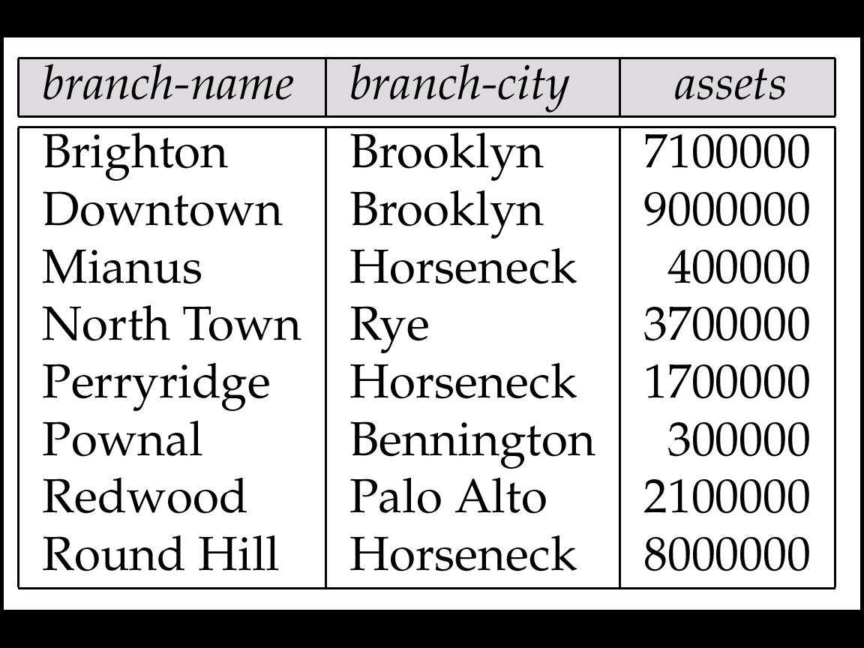
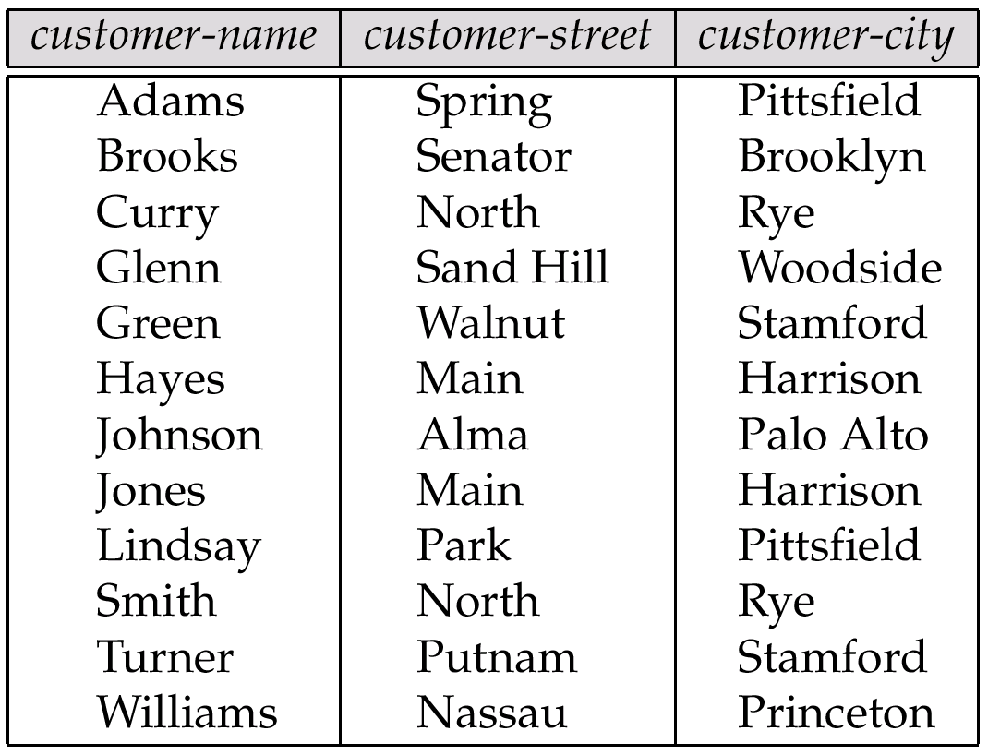
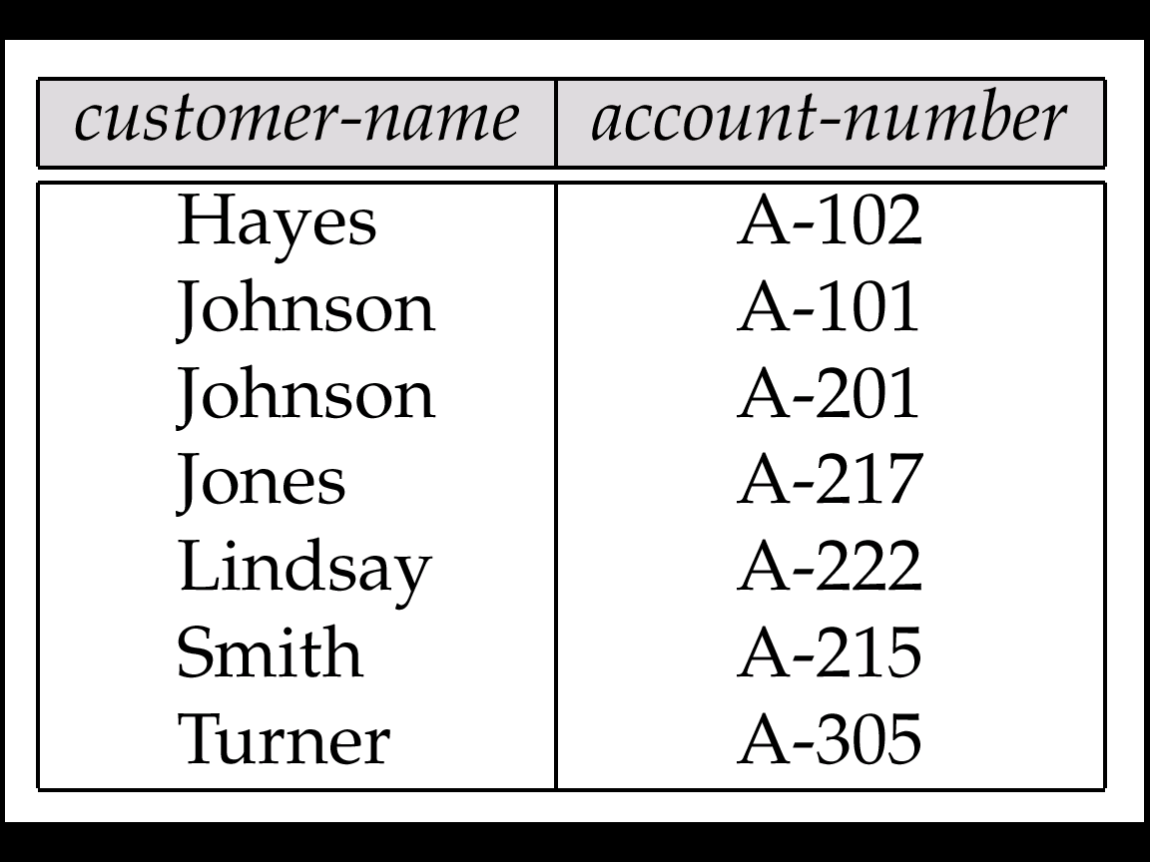
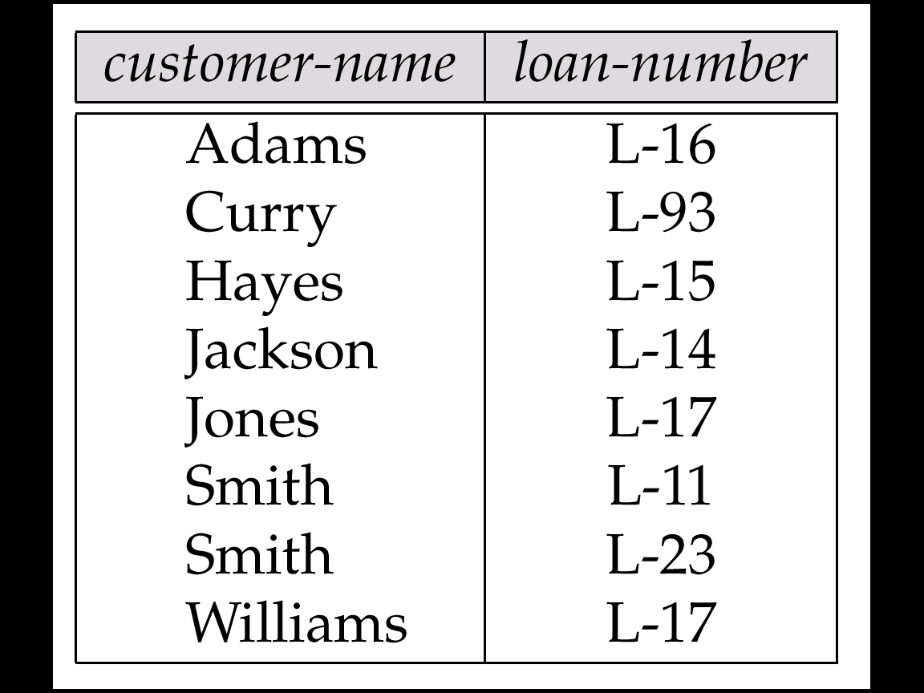
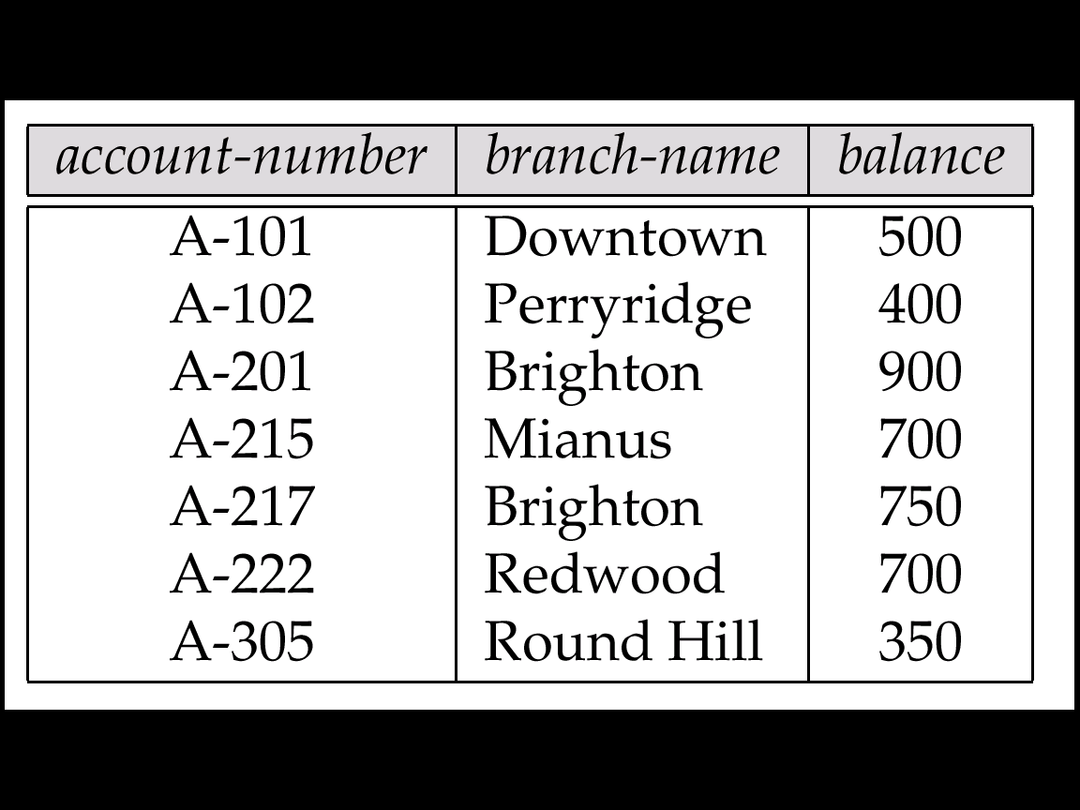
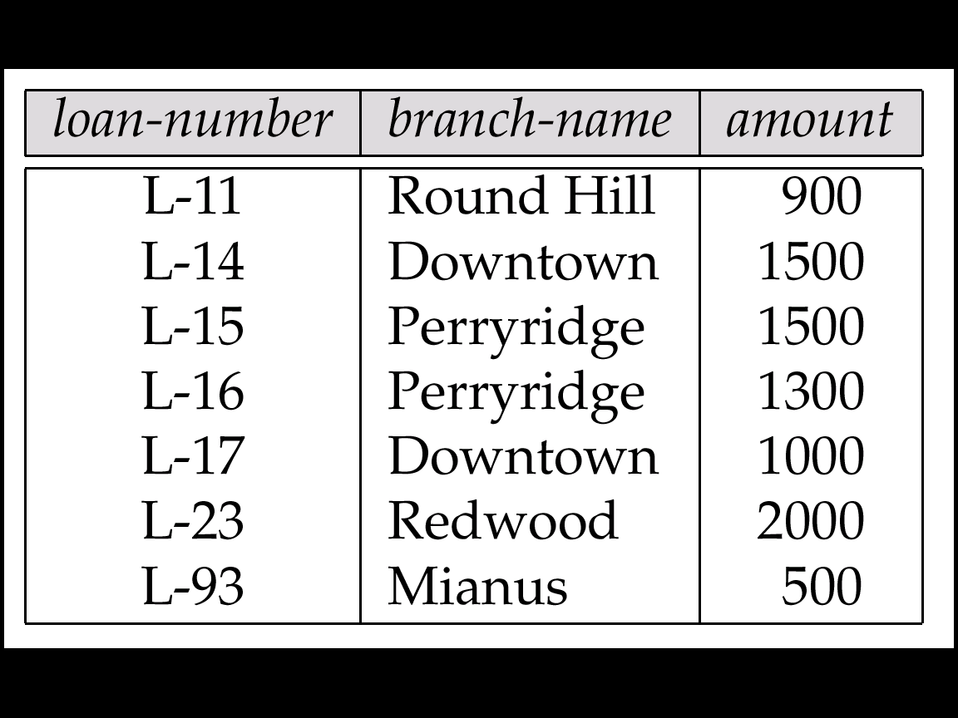
Example: Banking Database
1. branch
2. customer
客戶(存款戶,貸款戶)
3. depositor
存款戶
分公司
4. borrower
貸款戶
5. account
6. loan
存款帳
貸款帳
Source: A. Silberschatz, etc., Database System Concepts, 5th edition, McGraw Hill, 2006

Slide 14
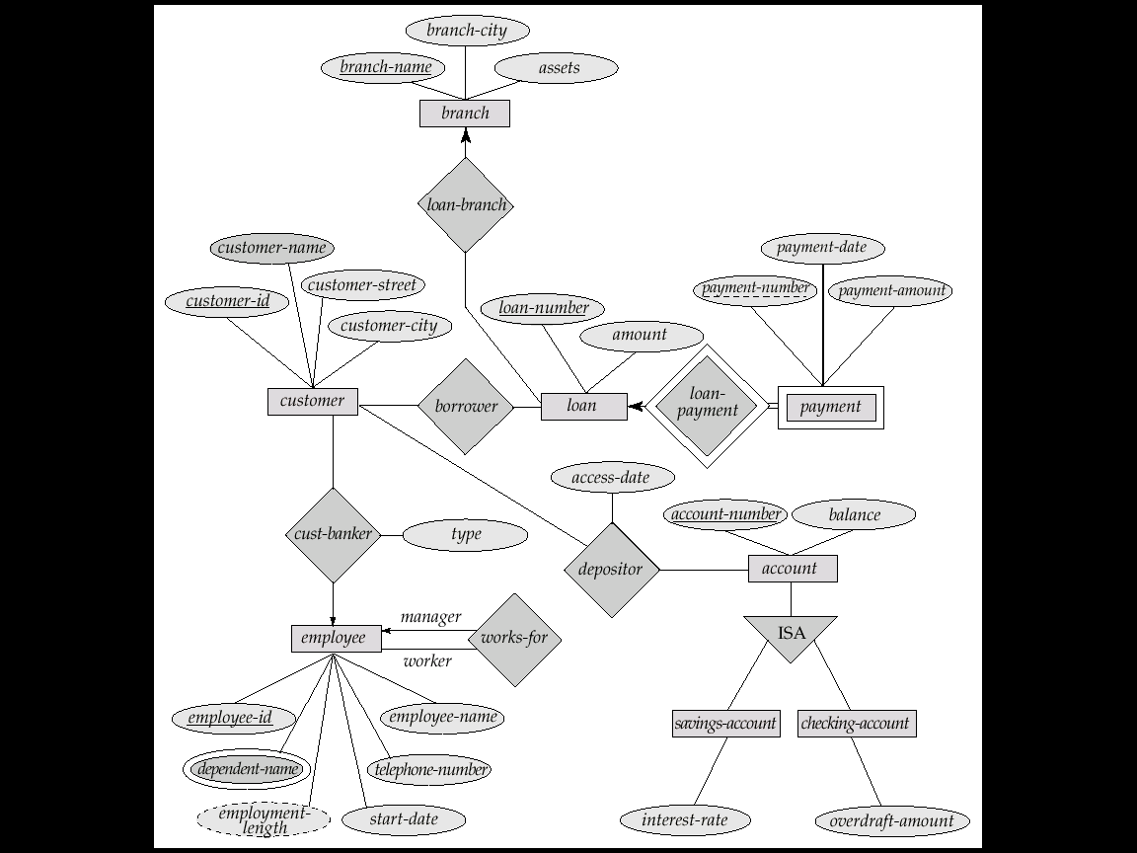
Real-world vs. E-R Model vs. Tables
The real-world enterprise
Semantic Data Model:
Entity-Relationship (E-R) Data Model
1. branch
分公司
2. customer
客戶(存款戶,貸款戶)
3. depositor
存款戶

Slide 15
Logical Database Design
Logical database design vs. Physical database design
Logical Database Design
Semantic Modeling, eg. E-R model
Normalization
Problem of Normalization
Given some body of data to be represented in a database, how to decide the suitable logical structure they should have?
what relations should exist?
what attributes should they have?

Slide 16
Problem of Normalization
<e.g.>
S1, Smith, 20, London, P1, Nut, Red, 12, London, 300
S1, Smith, 20, London, P2, Bolt, Green, 17, Paris, 200
.
.
S4, Clark, 20, London, P5, Cam, Blue, 12, Paris, 400
Normalization
S
P
SP
S# SNAME STATUS CITY
s1 . . London
. . . .
P# ... ... ...
. . . .
. . . .
S# P# QTY
. . .
. . .
S'
P
SP'
or
S# SNAME STATUS
S1 Smith .
S2 . .
. . .
P# ... ... ...
. . . .
. . . .
S# CITY P# QTY
S1 London P1 300
S1 London P2 200
. . . .
Redundancy Update Anomalies!
(異常)

Slide 17
6.2 The E-R Model

Slide 18
The E-R Model: Introduction
A database can be modeled as:
A collection of entities (objects), e.g. Students, Department are entities.
Relationship among entities (objects), e.g. major-in is a relationship.
E.g. Student Joni major-in Department of Information Management
Semantic Data Model:
Representation of the meaning of the data
Mapping the real-world enterprise onto a conceptual schema
E.g. E-R diagram for a banking enterprise
Entity-Relationship (E-R) Data Model:
Entity sets
Relationship sets
Attributes
語意

Slide 19
Example: Banking Database
Banking Database: consists 6 relations:
branch (branch-name, branch-city, assets)
customer (customer-name, customer-street, customer-only)
account (account-number, branch-name, balance)
loan (loan-number, branch-name, amount)
depositor (customer-name, account-number)
borrower (customer-name, loan-number)

Slide 20
Example: Banking Database
1. branch
2. customer
客戶(存款戶,貸款戶)
3. depositor
存款戶
分公司
4. borrower
貸款戶
5. account
6. loan
存款帳
貸款帳

Slide 21
E-R Diagram for a Banking Enterprise

Slide 22
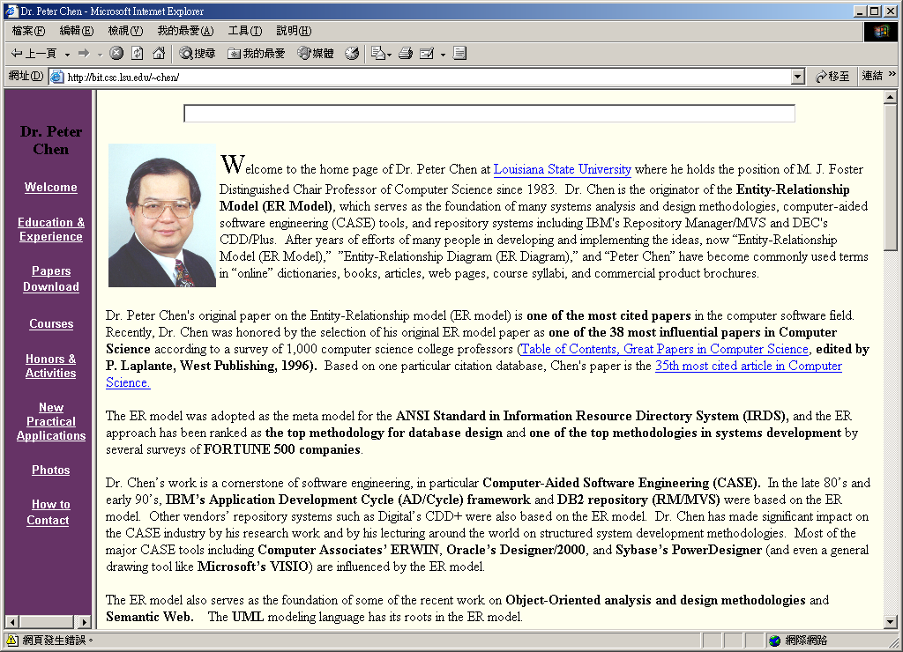

Slide 23
6.2.1 Entity Sets
A database can be modeled as:
a collection of entities, and
relationship among entities.
Entity:
is an object that exists and
is distinguishable from other objects.
Example: each person in an company, loans, holiday, ..
Entities have attributes
person have names and addresses
Entity set:
is a set of entities of the same type
that share the same properties or attributes.
Example: set of all persons who are customers at a given bank, can be defined as the entity set customer.

Slide 24
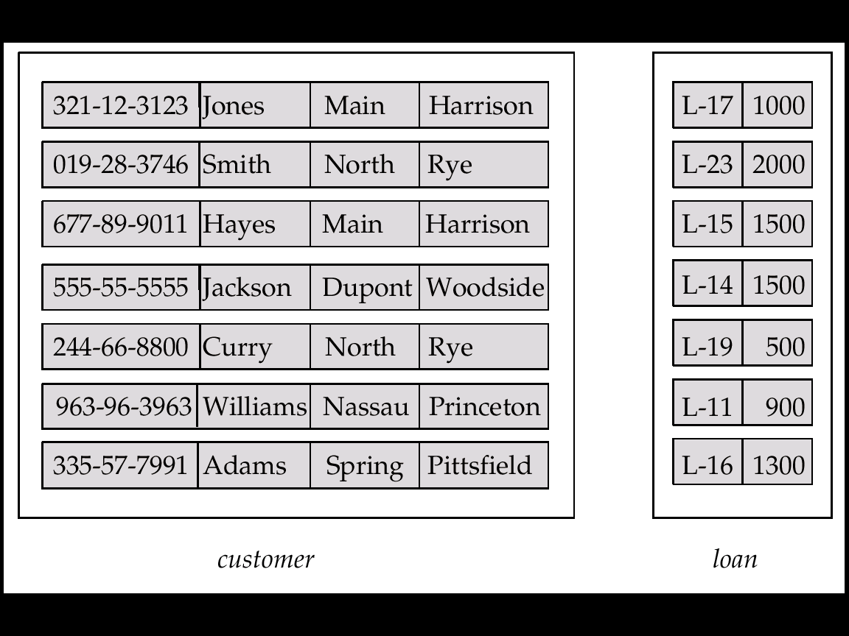
Entity Sets: Customer and Loan, Fig. 6.1
customer-id customer- customer- customer- loan- amount name street city number

Slide 25
6.2.2 Relationship Sets
Relationship: is an association among several entities
Example: Hayes depositor A-102 customer entity relationship set account entity
customer = (customer-name, customer-street, customer-city) account = (account-number, branch-name, balance)
customer
客戶(存款戶,貸款戶)
depositor
存款戶
account
存款帳

Slide 26
Relationship Sets (cont.)
Relationship Set:
is a set of relationships of the same types, e.g. depositor
Formally, is a mathematical relation among n ≥ 2 entities, each taken from entity sets E₁, E₂, …, E_{n},
then a relationship set R is a subset of
{(e₁, e₂, … e_{n}) | e₁ ∈ E₁, e₂ ∈ E₂, …, e_{n} ∈ E_{n}} where (e₁, e₂, …, e_{n}) is a relationship
Example:
(Hayes, A-102) ∈ depositor
4. depositor
Hayes ∈ ?
A-102 ∈ ?

Slide 27
E-R Diagram for a Banking Enterprise

Slide 28
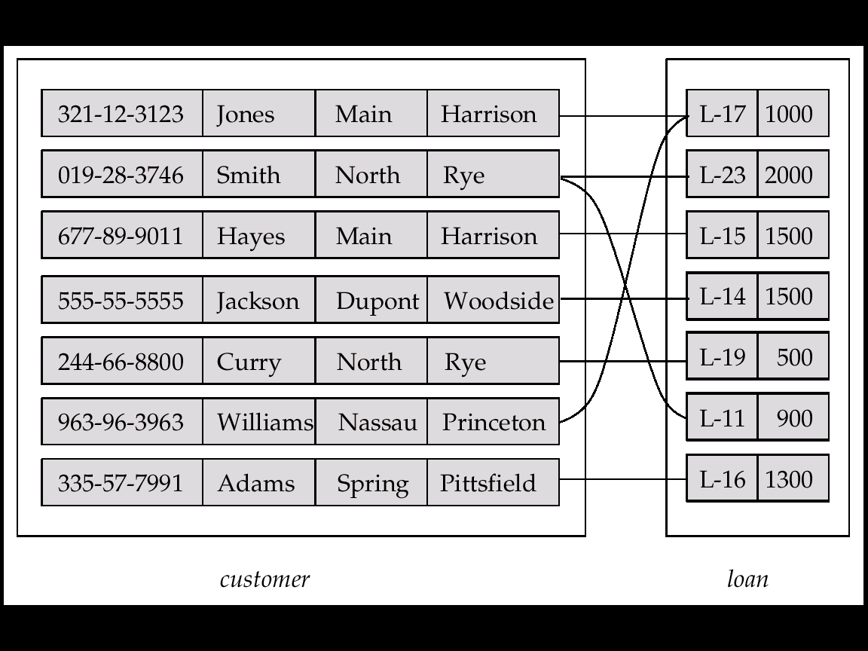
Relationship Set: borrower
借款戶
6. borrower
借款戶

Slide 29
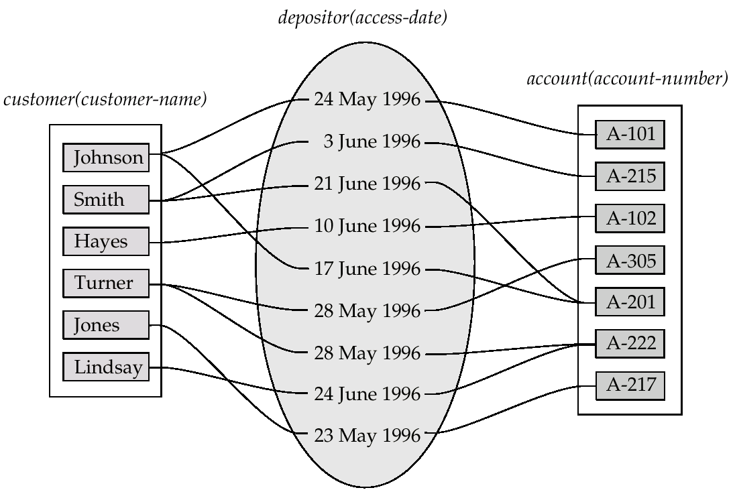
Relationship Sets (Cont.)
Relationship Set: can have attribute
E.g. access-date is the attribute of depositor
depositor
access-date

Slide 30
Degree of a Relationship Set
Degree of a Relationship Set: refers to number of entity sets that participate
Binary Relationship : Relationship sets that involve two entity sets are binary (or degree two).
Generally, most relationship sets are binary.
N-nary Relationship : Relationship sets may involve more than two entity sets.
E.g. Ternary Relationship
Suppose employees of a bank may have jobs (responsibilities) at multiple branches, with different jobs at different branches.
Ternary relationship set between entity sets employee, job, and branch
Fig. 6.12

Slide 31
6.2.3 Attributes
Attributes: descriptive properties possessed by all members of an entity set.
Example:
customer = (customer-id, customer-name, customer-street, customer-city) loan = (loan-number, amount)
Domain – the set of permitted values for each attribute
Attribute types:
Simple and composite attributes.
Single-valued and multi-valued attributes
E.g. Multivalued attribute: phone-numbers
Derived attributes
Can be computed from other attributes
E.g. age, given date of birth

Slide 32
Composite Attributes
Fig. 6.4

Slide 33
6.3 Constraints

Slide 34
Constraints in E-R Model
限制條件
Constraints: the contents of a database must conform.
E.g. balance > 0
E.g. A customer must have one and only one account
E.g. A customer can have more than one account
Constraints in E-R Model:
Mapping cardinality constraints
Key constraints
Participation constraints
一致, 規範, form

Slide 35
6.3.1 Mapping Cardinalities
Express the number of entities to which another entity can be associated via a relationship set.
Most useful in describing binary relationship sets.
For a binary relationship set the mapping cardinality must be one of the following types:
One to one
One to many
Many to one
Many to many

Slide 36
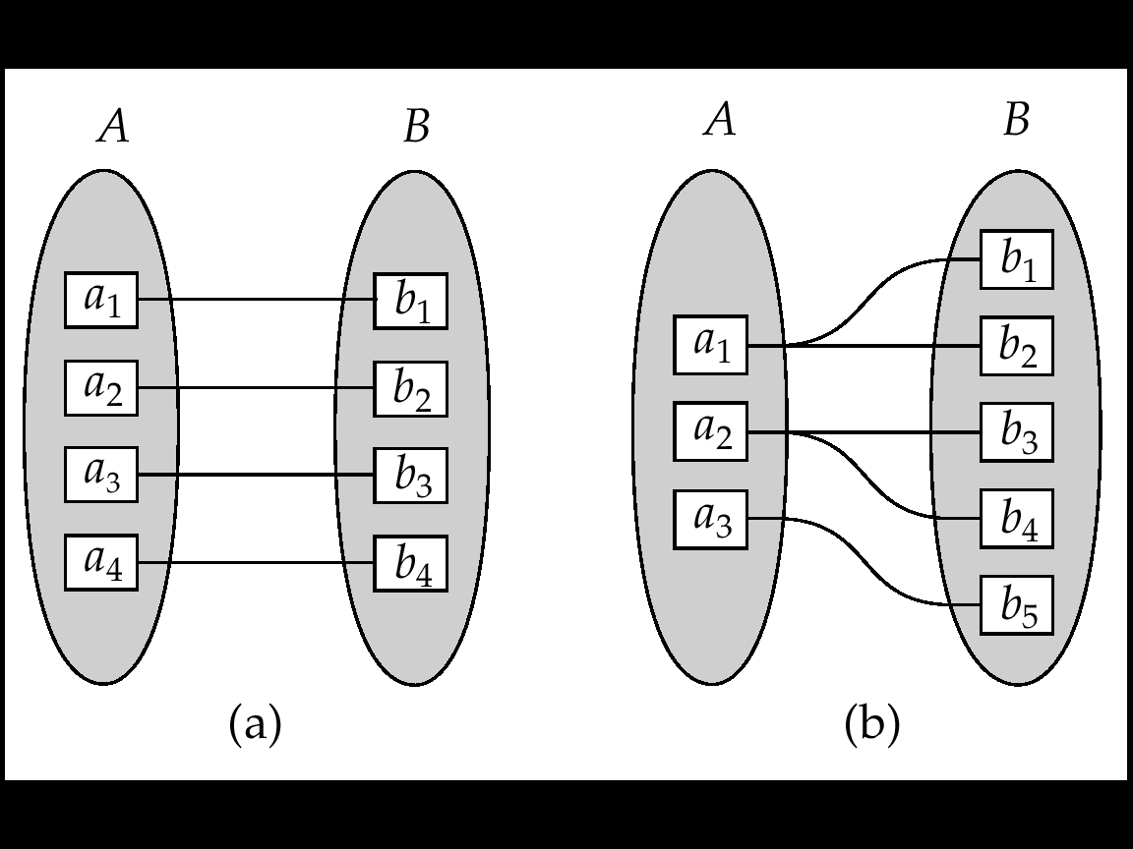
Mapping Cardinalities (Cont.)
One to one
One to many
Note: Some elements in A and B may not be mapped to any
elements in the other set

Slide 37
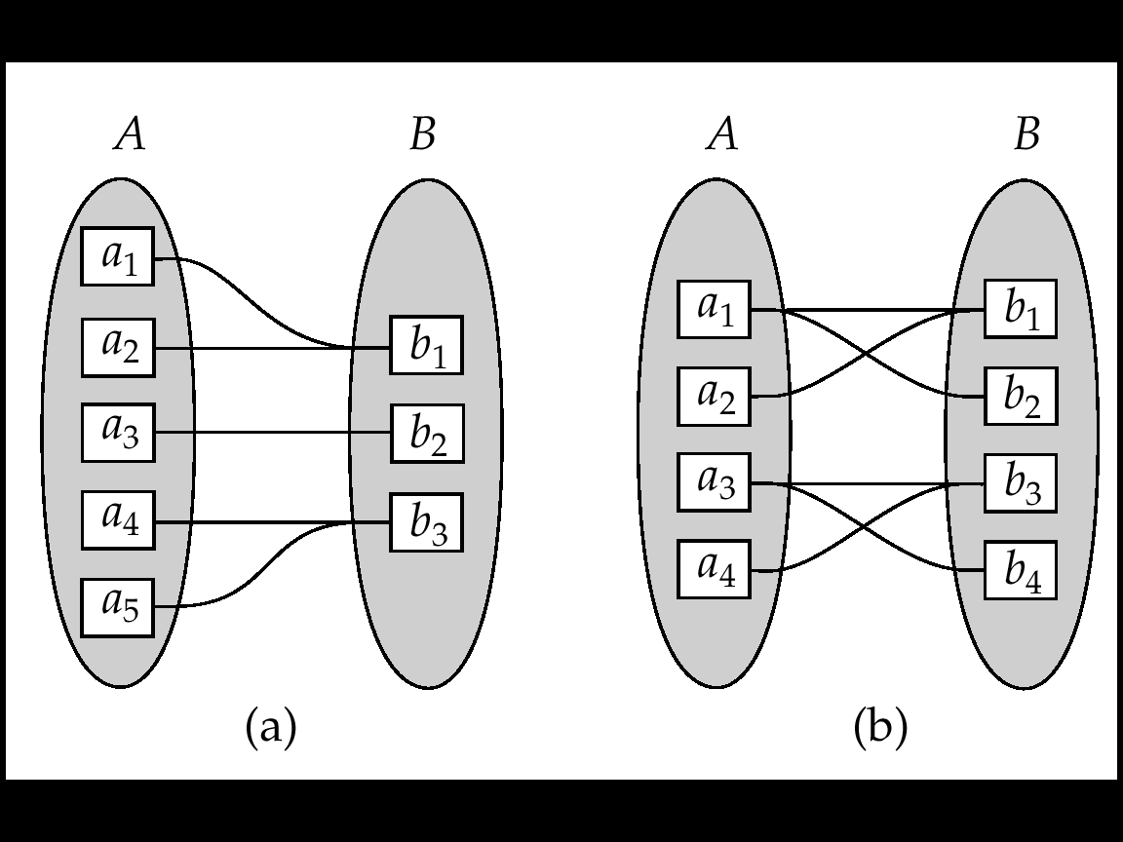
Mapping Cardinalities (cont.)
Many to one
Many to many
Note: Some elements in A and B may not be mapped to any
elements in the other set

Slide 38
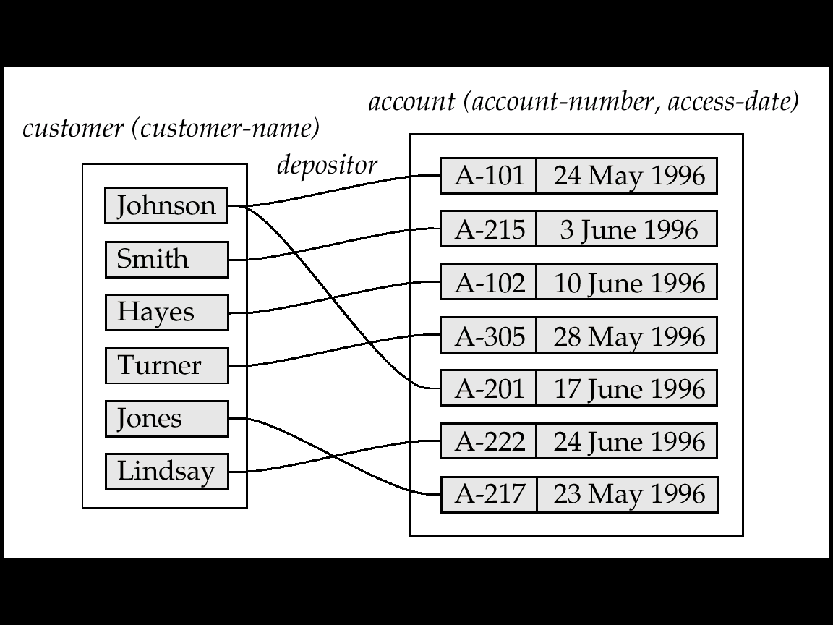
Mapping Cardinalities vs. Semantic Meaning
one to many vs. many to one
Semantic Meaning?

Slide 39
6.3.2 Key Constraints
Entity Set are distinguished
Individual entities are distinct
Difference among entities must be expressed in terms of their attributes
Uniquely identify the entity
Key
2. customer
id

Slide 40
Keys for Entity Sets
Super key: A super key of an entity set is a set of one or more attributes whose values uniquely determine each entity.
E.g. id, id + customer-name, ?+?+?, …
Candidate key: A candidate key of an entity set is a minimal super key
Customer-id is candidate key of customer
Customer-name is candidate key of customer
2. customer
id
Primary key: Several candidate keys may exist, one of the candidate keys is selected to be the primary key.
Need to consider semantics of relationship set in selecting
Address vs. Social Security Number ➔ change often ?

Slide 41
Keys for Relationship Sets
Super Key of a relationship set : The combination of primary keys of the participating entity sets forms a super key of a relationship set.
(customer-id, account-number) is the super key of depositor
Ref, p.217
2. customer
4. depositor
3. account
id
id

Slide 42
Keys for Relationship Sets (cont.)
Candidate Keys of a relationship set : Must consider the mapping cardinality of the relationship set when deciding the what are the candidate keys
Case 1: One to many from customer to account
Meaning: a customer can have many accounts
Key of depositor: is key of account
Case 2: Many to one from customer to account
Meaning: can have join account
Key of depositor: is key of customer
Case 3: One to one from customer to account
Meaning: a customer must have one and only one account
Key of depositor: either primary can be used
Case 4: Many to many
Meaning: a customer can have many accounts and join account
Key of depositor: is key of customer UNION key of account

Slide 43
Keys for Relationship Sets: Case 1
Case 1: One to many from customer to account
Meaning: a customer can have many accounts
Key of depositor: is key of account
1
n

Slide 44
Keys for Relationship Sets: Case 2
Case 2: many to One from customer to account
Meaning: can have join account
Key of depositor: is key of customer

Slide 45
Keys for Relationship Sets: Case 3
Case 3: One to one from customer to account
Meaning: a customer must have one and only one account
Key of depositor: either primary can be used

Slide 46
Keys for Relationship Sets: Case 4
Case 4: Many to many
Meaning: a customer can have many accounts and join account
Key of depositor: is key of customer UNION key of account

Slide 47
6.3.3 Participation Constraints
Total Participation: e.g. loan
The participation of loan in the relationship set borrow is total.
Partial Participation: e.g. customer
customer
loan
E1
E2
E3
E4
.
.
.
.
.
.
.
Relationship Set: borrower

Slide 48
6.4 E-R Diagrams

Slide 49
E-R Diagrams
E-R diagram:
Can express the overall logical structure of a database graphically
Simple and clear
Major components:
Rectangles: represent entity sets.
Diamonds: represent relationship sets.
Lines: link attributes to entity sets and entity sets to relationship sets.
Underline: indicates primary key attributes (will study later)

Slide 50
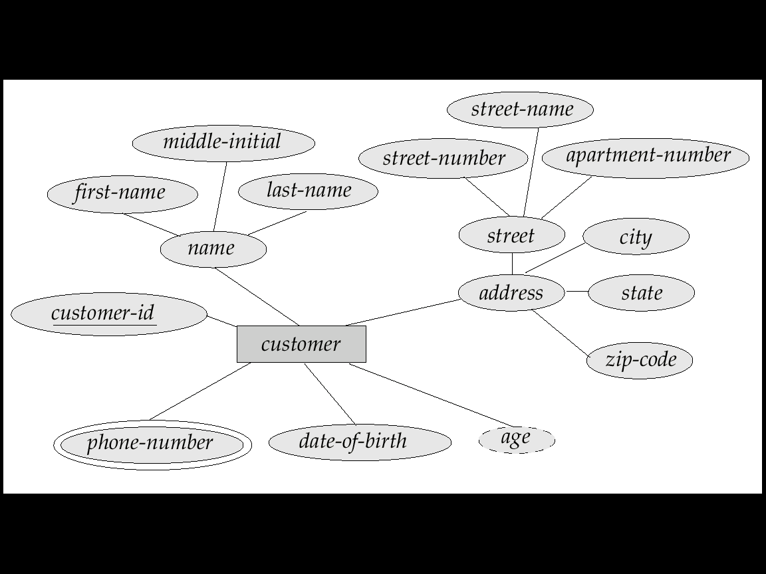
Fig.6.10 Composite, Multivalued, and Derived Attributes
E-R Diagrams (cont.)
Major components: (cont.)
Ellipses: represent attributes
Double ellipses represent multivalued attributes.
Dashed ellipses denote derived attributes.
Composite

Slide 51
E-R Diagrams: Cardinality Constraints
Express cardinality constraints
directed line (→), signifying “one” or
A undirected line (—), signifying “many”
E.g.: One-to-one relationship:
A customer is associated with at most one loan via the relationship borrower
A loan is associated with at most one customer via borrower
1
1

Slide 52
One-To-Many Relationship
In the one-to-many relationship a loan is associated with at most one customer via borrower, a customer is associated with several (including 0) loans via borrower
1
n

Slide 53
Many-To-One Relationships
In a many-to-one relationship a loan is associated with several (including 0) customers via borrower, a customer is associated with at most one loan via borrower
n
1

Slide 54
One-To-One Relationships
E.g.: One-to-one relationship:
A customer is associated with at most one loan via the relationship borrower
A loan is associated with at most one customer via borrower
1
1

Slide 55
Many-To-Many Relationship
n
n
A customer is associated with several (possibly 0) loans via borrower
A loan is associated with several (possibly 0) customers via borrower

Slide 56
Relationship Sets with Attributes
Attributes can be attached to a relation set
E.g. Attribute access-date is attached to depositor

Slide 57
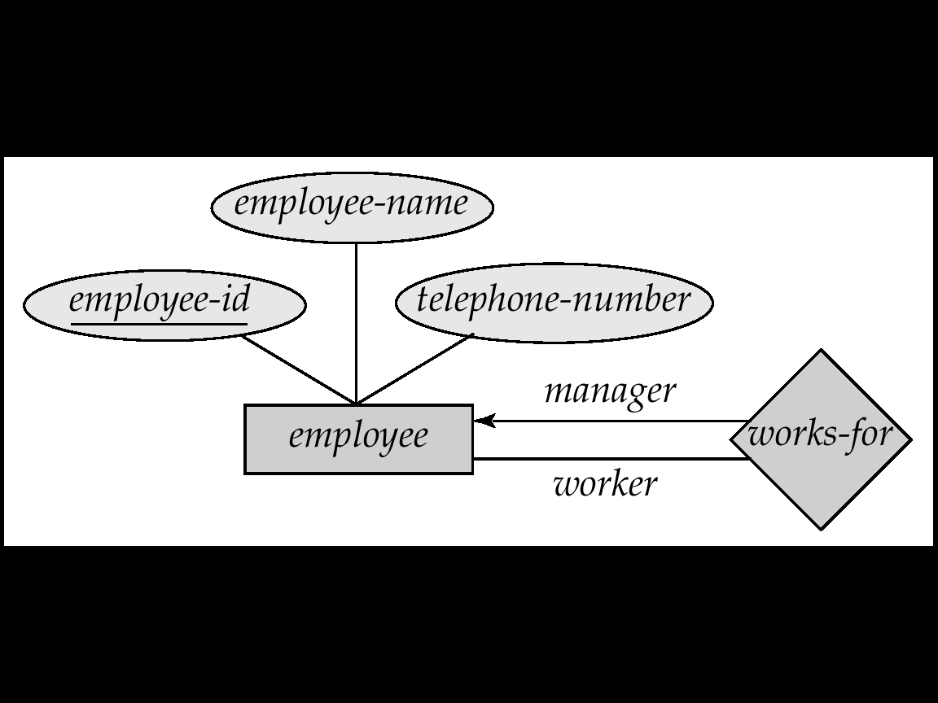
Role Indicator
Roles are indicated in E-R diagrams by labeling the lines that connect diamonds to rectangles.
Entity sets of a relationship need not be distinct
The labels “manager” and “worker” are called roles;
they specify how employee entities interact via the works-for relationship set.
Role labels are optional, and are used to clarify semantics of the relationship
1
employee
n

Slide 58
Ternary Relationship in E-R Diagram
Nonbinary relation ship sets: can be specified easily in an E-R diagram
Suppose “an employee can have at most one job in each branch”
e.g., Jones is a manager at Branch A, and an auditor at branch B)
This constraint can be specified by an arrow pointing to job from works-on
A one-to-many relationship
1
1
n

Slide 59
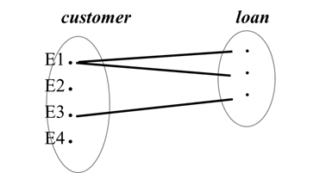
Participation
Total participation (indicated by double line): every entity in the entity set participates in at least one relationship in the relationship set
E.g. participation of loan in borrower is total
i.e. every loan must have a customer associated to it via borrower
Partial participation: some entities may not participate in any relationship in the relationship set
E.g. participation of customer in borrower is partial
Partial participation
Total participation

Slide 60
Cardinality Limits
Cardinality limits: form l..h, can also express participation constraints
compare
Partial participation
Total participation

Slide 61
E-R Diagram for a Banking Enterprise

Slide 62
6.5 E-R Design Issues

Slide 63
E-R Design Issues
6.5.1 Use of entity sets vs. attributes
Choice depends on the structure of the enterprise being modeled, and on the semantics associated with the attribute in question.
6.5.2 Placement of relationship attributes
add an attributes, e.g., access-date, where should we put it?

Slide 64
6.5.1 Entity Sets vs. Attributes
Consider a Entity Set: employee
with attributes (employee-id, employee-name, telephone-number)
telephone
Case 1: telephone-number as an attributes
Case 2: Create a entity set: telephone
entity set: telephone with attributes (telephone-number, location, type)
優點: can keep extra data, e.g. location, cell phone, fax, ..
缺點:
Note: not good to treat the attribute employee-name as an entity

Slide 65
Entity Sets vs. Attributes (cont.)
Question:
What constitutes an attributes?
What constitutes an entity set?
There are no simple answers
May depend on the real-world
and semantics of the attributes

Slide 66
6.5.2 Placement of Relationship Attributes
add an attributes, e.g., access-date, where should we put it?
Suppose we have entities customer, account, and relationship depositor:
If we are going to add a attributes access-date, where should we put it?
Case 1: depositor is a one-to-many relationship – put access-date in account

Slide 67
Placement of Relationship Attributes (cont.)
Case 2: depositor is a one-to-one relationship
put access-date in either entities or
Put access-date in relationship depositor
Case 3: depositor is a many-to-many relationship
Put access-date in relationship depositor
Fig. 2.6

Slide 68
6.6 Weak Entity Sets

Slide 69
Weak Entity Sets
Consider the following E-R diagram:
loan
Strong entity set (Identifying set, owner set)
Primary key : (loan-number)
Loan is said to own the payment
payment
Weak entity
Primary key for payment: (loan-number, payment-number)
Payment is said to be existence dependent on the entity set loan
能識別

Slide 70
Weak Entity Sets (cont.)
The existence of a weak entity set depends on the existence of a strong entity set
It must relate to the identifying entity set via a total, one-to-many relationship set from the identifying to the weak entity set
Weak relationship depicted using a double diamond
能識別
identifying entity set
weak entity set
能分辨者
Discriminator (or partial key): of a weak entity set is the set of attributes that distinguishes among all the entities. e.g. payment-number
Primary key of a weak entity set: is formed by
primary key of the strong entity set + weak entity set’s discriminator.

Slide 71
E-R Diagram for a Banking Enterprise

Slide 72
6.7 Reduction E-R Model to Relational Tables

Slide 73
Reduction to Relational Schemas
Reduction E-R Model to Relational Tables
A database which conforms to an E-R diagram can be represented by a collection of tables.
For each entity set there is a unique table which is assigned the name of the corresponding entity set.
For each relationship set ?
Converting an E-R diagram to a table format is the basis for deriving a relational database design from an E-R diagram.

Slide 74
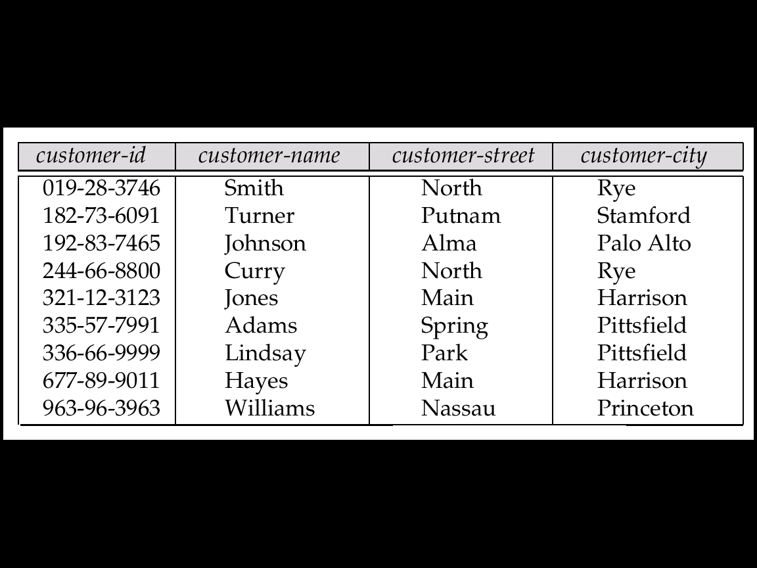
6.7.1 Strong Entity Set ➔ Table
E.g. Consider the strong entity set customer of E-R diagram
This customer entity set has 4 attributes
➔ corresponding table customer has four columns as follows:
A strong entity set reduces to a table with the same attributes.
customer

Slide 75
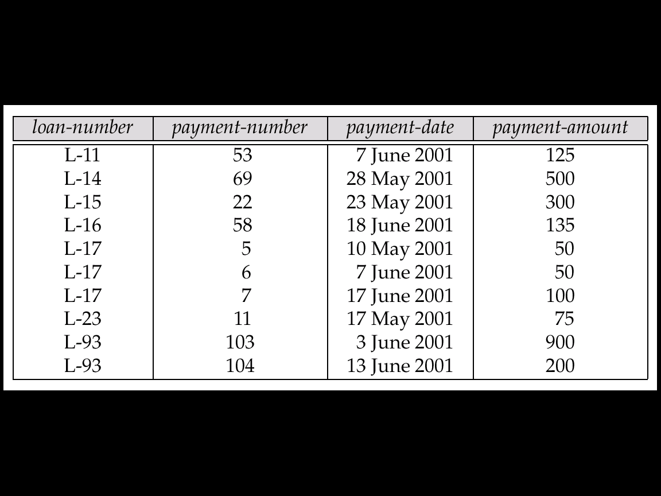
6.7.2 Weak Entity Set ➔ Table
A weak entity set becomes a table that includes a column for the primary key of the strong entity set
E.g. Consider weak entity payment that depends on loan
payment

Slide 76
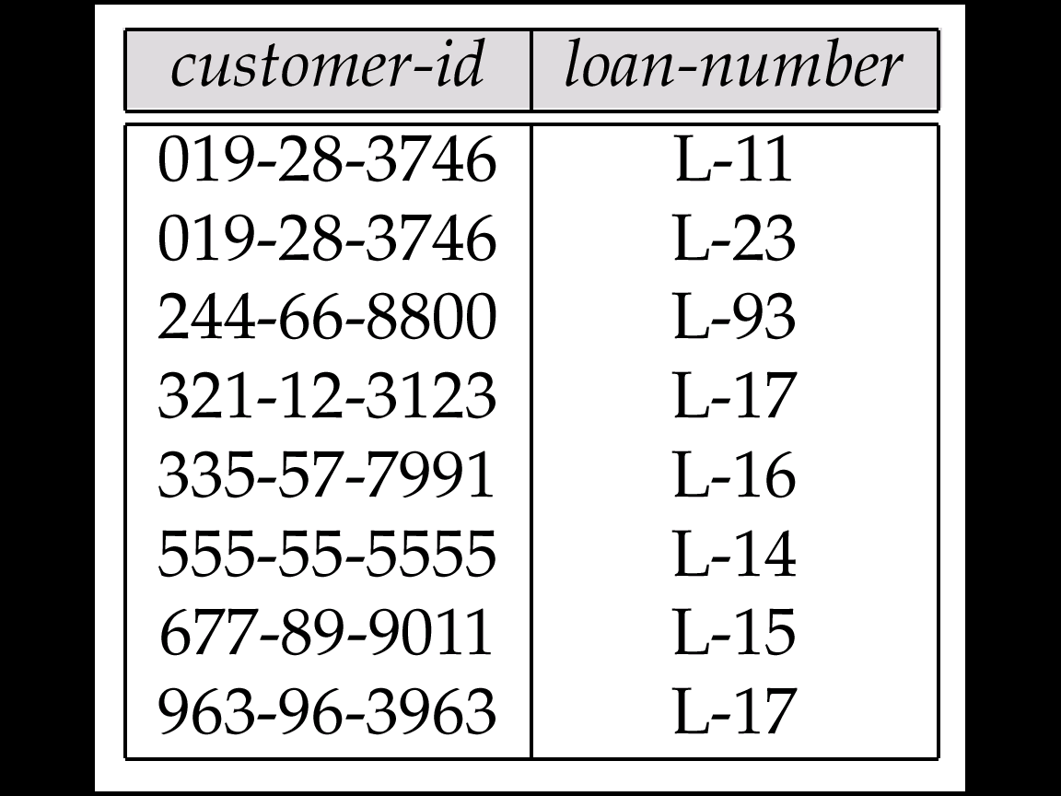
6.7.3 Relationship Set ➔ Table
Case 1: Many-to-Many Relationship Set ➔ Table
A many-to-many relationship set is represented as a table with columns for the primary keys of the two participating entity sets, and any descriptive attributes of the relationship set.
E.g.: table for relationship set borrower
borrower
n
n

Slide 77
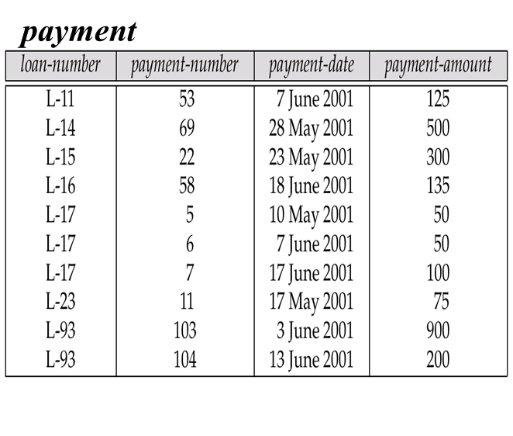
Relationship Set ➔ Table (cont.)
Case 2: Weak Relationship Set ➔ Table
The table corresponding to a relationship set linking a weak entity set to its identifying strong entity set is redundant.
E.g. The payment table already contains the information that would appear in the loan-payment table (i.e., the columns loan-number and payment-number).

Slide 78
Relationship Set ➔ Table (cont.)
Case 3: Many-to-One/One-to-Many Relationship Set ➔ Table
Many-to-one and one-to-many relationship sets that are total on the many-side can be represented by adding an extra attribute to the many side, containing the primary key of the one side
E.g.: Instead of creating a table for relationship account-branch, add primary key branch-name of branch to the entity set account
account
account-no
balance
branch-name
n
1
many side
one side

Slide 79
Relationship Set ➔ Table (cont.)
Case 4: One-to-One Relationship Set ➔ Table
For one-to-one relationship sets, either side can be chosen to act as the “many” side
That is, extra attribute can be added to either of the tables corresponding to the two entity sets
Ref. p. 6-28~30

Slide 80
6.7.4 Composite and Multivalued Attributes
Composite attributes are flattened out by creating a separate attribute for each component attribute
E.g. given entity set customer with composite attribute name with component attributes first-name and last-name the table corresponding to the entity set has two attributes name.first-name and name.last-name
first-name
last-name
customer
first-name
last-name
…
name
customer

Slide 81
PART II: 資料庫設計 (Database Design)
資料庫問題分析與架構規劃:
若有一大量資料想利用DBMS建資料庫來管理。第一步要分析問題，找到使用者需求
實體-關係模型(Entity-Relationship Model,簡稱E-R Model)是一套資料庫的設計工具。我們可以利用E-R Model分析資料庫問題。它可以把真實世界中複雜的問題中的事物和關係轉化為資料庫中的資料架構
由於利用實體-關係模型設計資料庫時, 並不會牽涉到資料庫的操作、儲存方式等複雜的電腦運作。所以,我們會把心力放在需求分析去規劃想要的資料庫，並以實體-關係圖(E-R Diagram)來呈現
資料庫的表格正規化:
實體-關係圖很容易轉化為表格(Tables)，而資料庫就是由許多表格(tables)組成的
這些表格要正規化(Normalization)才能避免將來操作時的異常現象發生
設計介面增刪查改資料庫:
如何方便、又有效率的管理存取資料庫是使用者最關心的二個要素
良好的介面設計，可以讓使用者方便的查詢、方便的新增、方便的刪除、方便的修改的處理資料庫

Slide 82
EX.part2.1: Problem and E-R Diagram
Problem Description
封面: 題目、組員
題目描述
Take any data you are familiar with. (from your work or ?)
System Analysis and Draw the E-R Diagram
系統分析與設計: using E-R Diagram
By using the E-R model to analysis and describe your data
Using any tools (e.g. Visio), and draw an E-R diagram
You can choose any “real system” as you like, for example:
A small Library System
Accounting System
…
A Banking Enterprise

Slide 83
end of unit 6

