Slide 1
Unit 1 Introduction to DBMS (Database Management Systems)
Application
program
DBMS
End-user

Slide 2
本課程講授內容
PART I: 入門與導論
Overview
DB2系統及SQL語言
闡述關連式資料模型(The Relational Model)
階層式資料模型(The Hierarchical Model)簡介
網狀式資料模型(The Network Model)簡介
PART II: 資料庫設計 (Database Design)
資料庫問題分析與 E-R Model
資料庫的表格正規化
設計介面增刪查改資料庫
PART III: 進階探討
快速存取方法(Access Methods)
資料庫回復(Database Recovery)
協同控制(Concurrency Control)
資料安全與資料正確(Security and Integrity)
查詢最佳化(Query Optimization)
分散式資料庫系統(Distributed Database)
1-2

Slide 3
PART I: 入門與導論
DB2系統及SQL語言:
介紹最多人使用的查詢語言SQL
配合實作習題，先試用一個免費的DBMS系統MySQL
好比要學開車可先在大停車場讓你繞一圈
這樣我們在介紹下單元關連式資料模型的設計原理時會比較容易想像
關連式資料模型(The Relational Model):
闡述使用者視資料庫為許多表格(tables)組成的關連式資料庫之原始設計原理
這是關連式資料庫的理論基礎
階層式資料模型(The Hierarchical Model)及網狀式資料模型(The Network Model):
這是最早的二個資料模型
介紹這二模型將有助於我們對資料庫模型更深入了解，並知其來龍去脈
我們將簡要的說明其原始設計原理
1-3

Slide 4
Contents of PART I: 入門與導論
Unit 1 Introduction to DBMS
Unit 2 DB2 and SQL
Unit 3 The Relational Model
Unit 4 The Hierarchical Model
Unit 5 The Network Model
----------------------------------------------------
References:
1. C. J. Date, An Introduction to Database Systems, 8th edition, 2004.
2. J. D. Ullman, Principles of Database and Knowledge-Base, Vol.I, 1988.
3. Cited papers

Slide 5
Outline of Unit 1
1.1 Information Systems
1.2 An Overview of a Database System
1.3 Why Database Systems?
1.4 An Architecture for a Database System
1.5 Data Models
1.6 Establish/Design a Database System
1.7 Extending Database Technology
1.8 Discussion and Remarks

Slide 6
1.1 Information Systems

Slide 7
Stages of Information System
Stage 0: Manual Information System
Records
Files
Index Cards
Stage 1: Sequential Information Systems
Tapes
Files
slow, non-interactive, redundancy,... .
Stage 2: File Based Information Systems
Disk (direct access)
application program has its own file data dependence
data redundancy
Stage 3: DBMS based Information Systems
Generalized data management software
Transaction processing

Slide 8
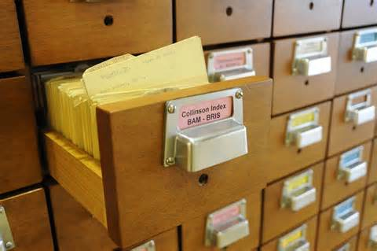
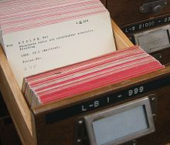
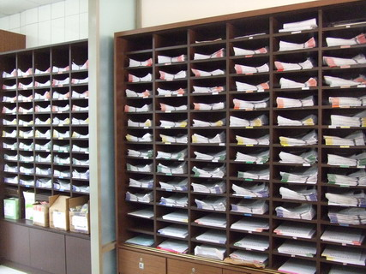
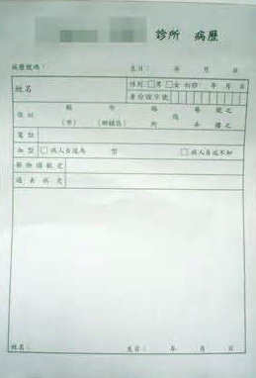
Stage 0: Manual Information System
圖書館index card
醫院診所病歷卡

Slide 9
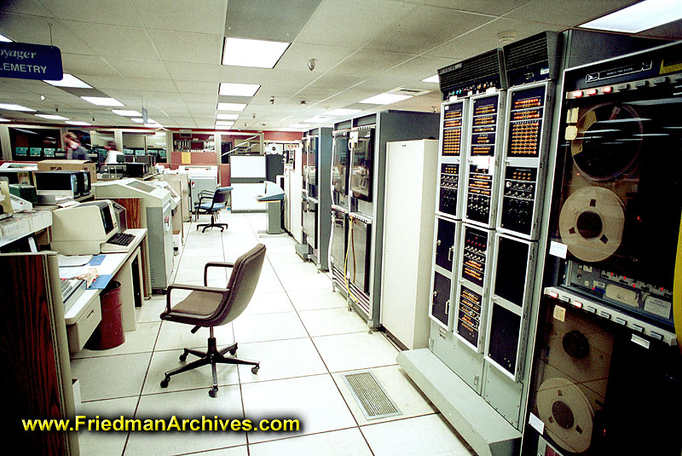
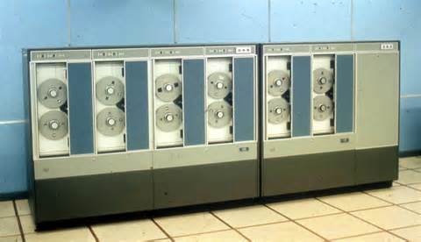
Stage 1: Sequential Information Systems
The old computer data center at NASA's Jet Propulsion Laboratory ...

Slide 10
Stage 2: File Based Information Systems
Conventional Data Processing techniques:
Enterprise:
Application Program A
Customer
Application System A
File System A
Application System B
Application Program B
File System B
Invoice
…
Application System N
Application Program N
Inventory
File System N

Slide 11
Stage 2: File Based Information Systems (cont.)
Customer
Invoice
Customer No.
Customer Name
Customer Addr.
Social Security ID
Customer No.
Customer Name
Part No.
Quantities
Unit Price
Inventory
Parts
Part No.
Part Description
Unit Price
Supplier
Quantities Remain
Quantities Ordered
Part No.
Part Description
Supplier
Quantities Ordered
Customer Name
Unit Price

Slide 12
Stage 2: File Based Information Systems (cont.)
Advantages: File Systems are simple in design
Disadvantages:
Data Redundancy:
a waste of memory
high update cost
data inconsistency
Data Incompleteness
Data Insecure
Application Program Unstable
file system (application program)
data changed data structure changed
program changed

Slide 13
Solution: Database Systems!
Objectives of Database Systems:
eliminate unnecessary data redundancy
maintain data integrity
control security
achieve data independence
add program stability

Slide 14
Stage 3: DBMS based Information Systems: Basic Approach - Integration
(1) Integration of Information
Description of the integrated view of data is the "Conceptual Schema" of the database
DBMS
Application
program
End-user

Slide 15
Stage 3: DBMS based Information Systems: Basic Approach – Simple views and High level language
(2) Provide simple views (External Schema) and high level language (e.g. SQL) for users to manipulate (handle) data
High level language: e.g. SQL (Structured Query Language)
<e.g.>: SELECT SNAME
FROM S
WHERE S#= 'S4';
Description of user's view of data is the "external schema" or "subschema" or "view".
High-level languages (Query Language): SQL
(1) Data Definition Language:
define format
(2) Data Manipulation Language:
retrieve, insert, delete, update
Emphasize: EASE OF USE !!
S
S# SNAME STATUS CITY
S1 Smith 20 London
S2 Jones 10 Paris
S3 Blake 30 Paris
S4 Clark 20 London
S5 Adams 30 Athens

Slide 16
Stage 3: DBMS based Information Systems: Basic Approach - Storage/Access Method
(3) Efficient Storage/Access Techniques:
implemented once rather than duplicated in all application programs.
User: query in SQL
Language Processor
DBMS
Access Methods Calls
Access Method
(B+ tree, Dynamic Hashing)
I/O calls

Slide 17
Stage 3: DBMS based Information Systems: Basic Approach - Transaction Management
(4) Provide Transaction Management:
Concurrency Control
Recovery
Security
.
:

Slide 18
Example: A Simple Query Processing
Query in SQL：
SELECT CUSTOMER. NAME
FROM CUSTOMER, INVOICE
WHERE REGION = 'N.Y.' AND
AMOUNT > 10000 AND
CUTOMER.C#=INVOICE.C
DBMS
Language Processor
Internal Form :
Π(σ (S SP)
Optimizer
Language
Processor
Operator :
SCAN C using region index, create C
SCAN I using amount index, create I
SORT C?and I?on C#
JOIN C?and I?on C#
EXTRACT name field
Operator Processor
Calls to Access Method：
OPEN SCAN on C with region index
GET next tuple
.
.
.
Access Method
e.g.B-tree; Index;
Hashing
Access
Method
File System
Calls to file system：
GET10th to 25th bytes from
block #6 of file #5
database

Slide 19
1.2 An Overview of a Database System

Slide 20
Database System: Introduction
Database Management System (DBMS)
Contains a large bodies of information
Collection of interrelated data (database)
Set of programs to access the data
Goal of a DBMS:
provides a way to store and retrieve database information
convenient and
efficient

Slide 21
Database System: Functions of DBMS
Functions of DBMS: Management of Data (MOD)
Defining structure for storage data
Proving mechanisms for manipulation of data
Ensure safety of data (system crashes, unauthorized access, misused, …)
Concurrent control in multi-user environment
Computer Scientists:
Developed a lot of concepts and techniques for MOD
Concepts and techniques form the focus of this course

Slide 22
Database System: Data Integrated and Shared
DBMS
Application
program
End-user

Slide 23
Database System: Major components
Data: integrated and shared
Hardware: disk, CPU, Main Memory, ...
Software: DBMS
Users:
1. Application programmers
2. End users
3. Database administrator (DBA)
Defining external schema
Defining conceptual schema
Defining internal schema
Liaison with users
Defining security and integrity checks
Defining backup and recovery procedures
Monitoring performance and changing requirements

Slide 24
An Example: Supplier-and-Parts Database
<e.g.> Supplier-and-Parts Database
S
S# SNAME STATUS CITY
S1 Smith 20 London
S2 Jones 10 Paris
S3 Blake 30 Paris
S4 Clark 20 London
S5 Adams 30 Athens
P
P# PNAME COLOR WEIGHT CITY
P1 Nut Red 12 London
P2 Bolt Green 17 Paris
P3 Screw Blue 17 Rome
P4 Screw Red 14 London
P5 Cam Blue 12 Paris
P6 Cog Red 19 London
SP
S# P# QTY
S1 P1 300
S1 P2 200
S1 P3 400
S1 P4 200
S1 P5 100
S1 P6 100
S2 P1 300
S2 P2 400
S3 P2 200
S4 P2 200
S4 P4 300
S4 P5 400
Query:
列出住在London 的供應商名字?
Get the total number of suppliers.
Total QTY of SP?
Get supplier names for suppliers who supply part P2?
Get supplier names for suppliers who supply red color parts?
…

Slide 25
1.3 Why Database System?

Slide 26
Why Database System?
Answer: Easy to retrieve information!
Word, Excel vs. Access
Query:
列出住在London 的供應商名字?
Get the total number of suppliers.
Total QTY of SP?
Get supplier names for suppliers who supply part P2?
Get supplier names for suppliers who supply red color parts?
…
<e.g.> Supplier-and-Parts Database
S
S# SNAME STATUS CITY
S1 Smith 20 London
S2 Jones 10 Paris
S3 Blake 30 Paris
S4 Clark 20 London
S5 Adams 30 Athens
SP
S# P# QTY
S1 P1 300
S1 P2 200
S1 P3 400
S1 P4 200
S1 P5 100
S1 P6 100
S2 P1 300
S2 P2 400
S3 P2 200
S4 P2 200
S4 P4 300
S4 P5 400
P
P# PNAME COLOR WEIGHT CITY
P1 Nut Red 12 London
P2 Bolt Green 17 Paris
P3 Screw Blue 17 Rome
P4 Screw Red 14 London
P5 Cam Blue 12 Paris
P6 Cog Red 19 London

Slide 27
Retrieval Operations
Easy to retrieve information!
P
P# PNAME COLOR WEIGHT CITY
P1 Nut Red 12 London
P2 Bolt Green 17 Paris
P3 Screw Blue 17 Rome
P4 Screw Red 14 London
P5 Cam Blue 12 Paris
P6 Cog Red 19 London
Get color and city for "non-Paris" parts with weight greater than ten.
SELECT P.COLOR, P.CITY
FROM P
WHERE P.CITY < > 'Paris'
AND P.WEIGHT > 10;
DISTINCT
SELECT DISTINCT P.COLOR, P.CITY
FROM P
WHERE P.CITY < > 'Paris'
AND P.WEIGHT > 10;

Slide 28
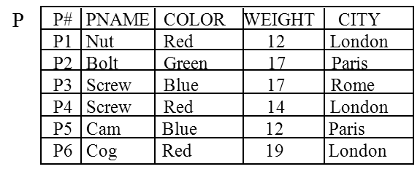
Retrieval Operations (cont.)
For all parts, get the part number and the weight
of that part in grams.
SELECT P.P#, P.WEIGHT * 454 AS GMWT FROM P ;
Get the maximum and minimum quantity for part P2.
SELECT MAX (SP.QTY) AS MAXQ,
MIN (SP.QTY) AS MINQ
FROM SP
WHERE SP. P# = 'P2';
For each part supplied, get the part number and the
total shipment quantity.
SELECT SP.P#, SUM (SP.QTY) AS TOTQTY
FROM SP
GROUP BY SP.P#;
SP
S# P# QTY
S1 P1 300
S1 P2 200
S1 P3 400
S1 P4 200
S1 P5 100
S1 P6 100
S2 P1 300
S2 P2 400
S3 P2 200
S4 P2 200
S4 P4 300
S4 P5 400

Slide 29
Retrieval Operations (cont.)
Get part numbers for all parts supplied by more than one supplier.
SELECT SP.P#
FROM SP
GROUP BY SP.P#
HAVING COUNT ( SP. S# ) > 1;
Get supplier names for suppliers who supply part P2.
SELECT DISTINCT S.SNAME
FROM S
WHERE S. S# IN
( SELECT SP. S#
FROM SP
WHERE SP.P# = 'P2‘);
<e.g.> Supplier-and-Parts Database
S
S# SNAME STATUS CITY
S1 Smith 20 London
S2 Jones 10 Paris
S3 Blake 30 Paris
S4 Clark 20 London
S5 Adams 30 Athens
SP
S# P# QTY
S1 P1 300
S1 P2 200
S1 P3 400
S1 P4 200
S1 P5 100
S1 P6 100
S2 P1 300
S2 P2 400
S3 P2 200
S4 P2 200
S4 P4 300
S4 P5 400
P
P# PNAME COLOR WEIGHT CITY
P1 Nut Red 12 London
P2 Bolt Green 17 Paris
P3 Screw Blue 17 Rome
P4 Screw Red 14 London
P5 Cam Blue 12 Paris
P6 Cog Red 19 London

Slide 30
Why Database ?
Easy to retrieve information!
Redundancy can be reduced
Inconsistency can be avoided
The data can be shared
Standards can be enforced
Security restrictions can be applied
Integrity can be maintained
Provision of data independence
Database Growth Fast!
objective !

Slide 31
Why Database: Redundancy can be reduced
Customer
Invoice
Customer No.
Customer Name
Customer Addr.
Social Security ID
Customer No.
Customer Name
Part No.
Quantities
Unit Price
Inventory
Parts
Part No.
Part Description
Unit Price
Supplier
Quantities Remain
Quantities Ordered
Part No.
Part Description
Supplier
Quantities Ordered
Customer Name
Unit Price

Slide 32
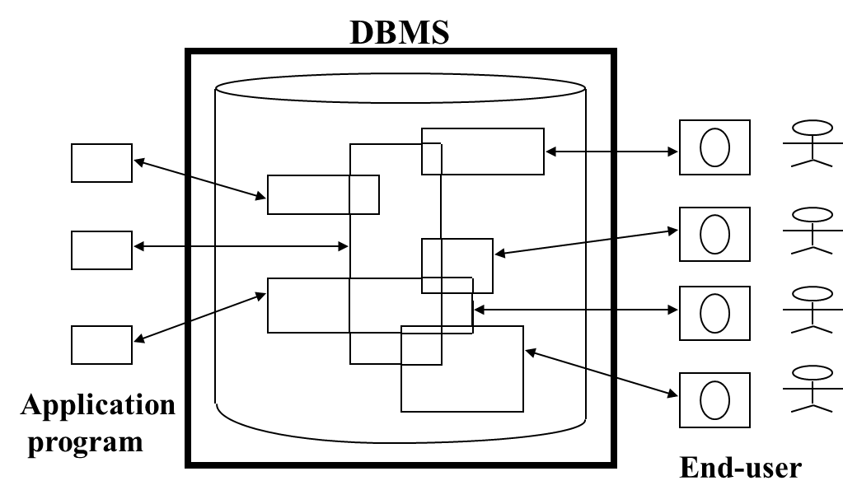
Why Database: The data can be shared

Slide 33
Why Database: Security restrictions can be applied
user
S
S# SNAME STATUS CITY
S1 Smith 20 London
S2 Jones 10 Paris
S3 Blake 30 Paris
S4 Clark 20 London
S5 Adams 30 Athens
DBMS
File Manager
O.S.
DB

Slide 34
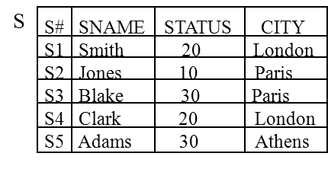
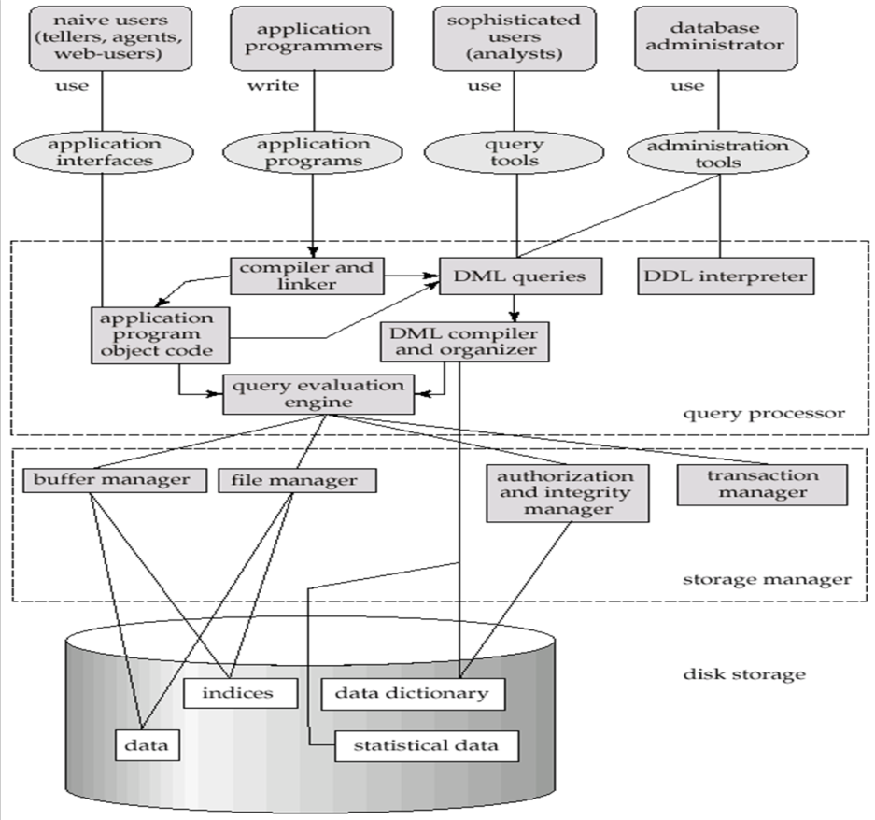
Why Database: Integrity can be maintained
Consider Supplier-and-Parts Database,
Assume the STATUS should always be positive value.
CREATE INTEGRITY RULE
CREATE INTEGRITY RULE R1
ON INSERT S.STATUS,
UPDATE S.STATUS;
CHECK FORALL S ( S.STATUS > 0 )
ELSE REJECT;

Slide 35
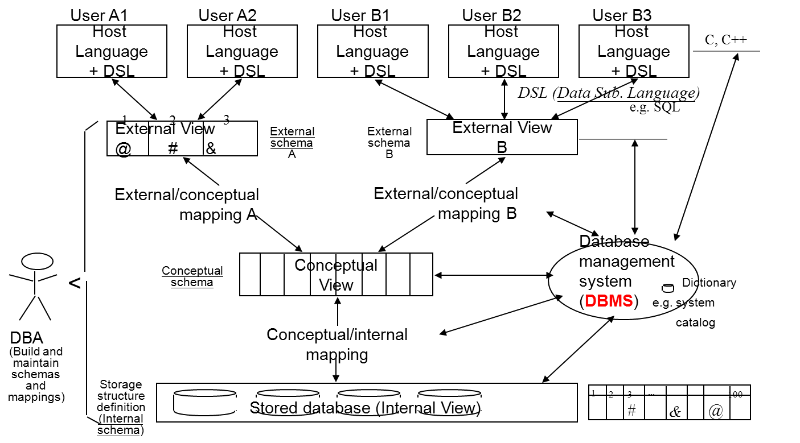
Why Database: Provision of data independence

Slide 36
Data Independence
Application Program
➔ Data Structure
Immunity of application to change in storage structure and access strategy.

Slide 37
Data Dependence vs. Data Independence
Data Dependent
e.g. SELECT CITY
FROM S
WHERE ITEM = 'X';
Linked list: TOP
if item = TOP . item then .........
Tree:
.
if item < root.data then root := root.left ..........
Array:
if A[I] = item then ............
Storage structure changed ➔ program changed
S
S# SNAME STATUS CITY
S1 Smith 20 London
S2 Jones 10 Paris
S3 Blake 30 Paris
S4 Clark 20 London
S5 Adams 30 Athens
S Top
s1
s2
sn

Slide 38
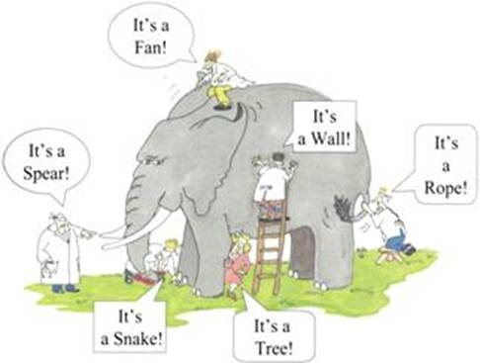
1.4 An Architecture for a Database System

Slide 39
Architecture for a Database System: view 1
Query
DBMS
Language Processor
Optimizer
Operation Processor
Access Method
File Manager
Database

Slide 40
Querying and Data Storage
Components of Database System
Query Processor
Helps to simplify to access data
High-level view
Users are not be burdened unnecessarily with the physical details
Storage Manager
Require a large amount of space
Can not store in main memory
Disk speed is slower
Minimize the need to move data between disk and main memory
Query
DBMS
Language Processor
Optimizer
Query Processor
Operation Processor
Access Method
Storage Manager
File Manager
Goal of a DBMS: provides a way to store and retrieve data that is both convenient and efficient.
Database

Slide 41
Architecture for a Database System: view 2
User A1
User A2
User B1
User B2
User B3
Host
Language
+ DSL
Host
Language
+ DSL
Host
Language
+ DSL
Host
Language
+ DSL
Host
Language
+ DSL
C, C++
DSL (Data Sub. Language)
e.g. SQL
1
2
3
External View
B
External View
@ # &
External
schema
A
External
schema
B
External/conceptual
mapping A
External/conceptual
mapping B
Conceptual
View
Database
management
system Dictionary
(DBMS) e.g. system
catalog
<
Conceptual
schema
DBA
Conceptual/internal
mapping
(Build and
maintain
schemas
and
mappings)
Storage
structure
definition
(Internal
schema)
1
2
3
...
100
Stored database (Internal View)
#
&
@

Slide 42
Overall System Structure
low-level data stored
database

Slide 43
Data Dictionary in DBMS
SELECT S.SNAME
FROM S
WHERE S. S.CITY = “London”;
Application Program
9
Request
Working Area
return
1
8
7
6
2
System Buffer
DBMS
Data Dictionary
3
5
OS
CREATE TABLE S
(S# CHAR (5) NOT NULL,
SNAME CHAR (20),
STATUS SMALLINT,
CITY CHAR (15));
Secondary Memory
Database
4

Slide 44
Architecture for a Database System: view 3
Scan figure

Slide 45
Architecture for a Database System: view 4
Scan figure

Slide 46
1.5 Data Models

Slide 47
Data Models:
Hierarchical Data Model
Network Data Model
Relational Data Model
Object-Oriented Data Model
…

Slide 48
Hierarchical Data Model
“Data Pile”
course# name prereq.1 prereq.2 off.1 92/9/6 EE108 T003 Yang
course# name prereq off. 1 off. 2
Course
92/9/6
Course#
Title
prereq.1 prereq.2
PreReq
Offering
Prereq.#
Off.#
Date
Location
Teacher
Student
Emp.#
Name
Emp.#
Name
Grade

Slide 49
Network Data Model
S
P
S# SNAME STATUS CITY
S-SP
P-SP
(Links)
SP
QTY

Slide 50
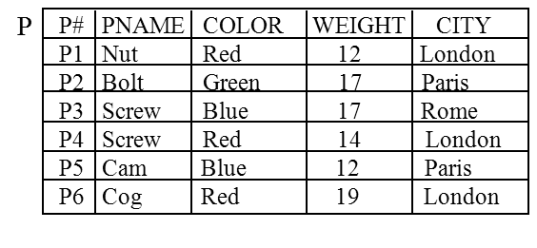
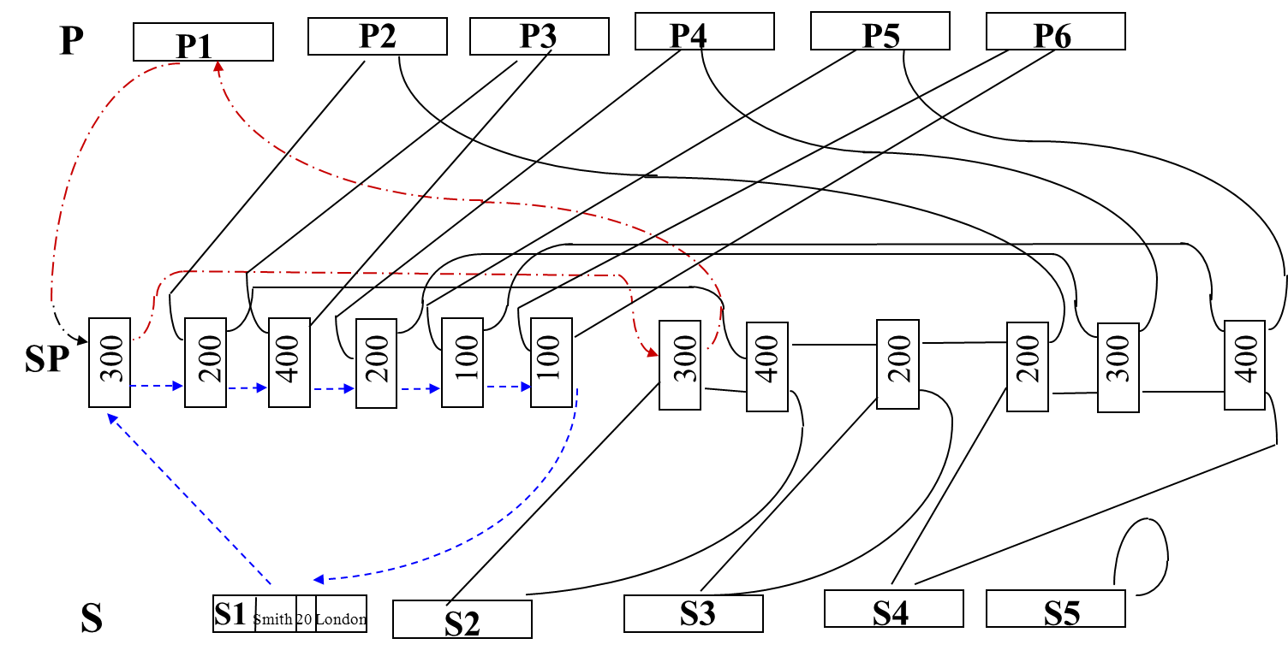
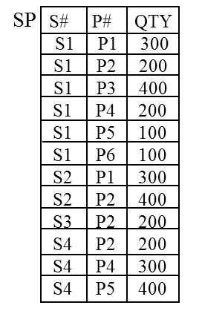
The Network Model: Sample Values

Slide 51
Relational Data Model: [Codd70]
System R
DB2
INGRES
Oracle
Informix
ACCESS
mySQL
…
<e.g.> Supplier-and-Parts Database
S
S# SNAME STATUS CITY
S1 Smith 20 London
S2 Jones 10 Paris
S3 Blake 30 Paris
S4 Clark 20 London
S5 Adams 30 Athens
SP
S# P# QTY
S1 P1 300
S1 P2 200
S1 P3 400
S1 P4 200
S1 P5 100
S1 P6 100
S2 P1 300
S2 P2 400
S3 P2 200
S4 P2 200
S4 P4 300
S4 P5 400
P
P# PNAME COLOR WEIGHT CITY
P1 Nut Red 12 London
P2 Bolt Green 17 Paris
P3 Screw Blue 17 Rome
P4 Screw Red 14 London
P5 Cam Blue 12 Paris
P6 Cog Red 19 London

Slide 52
Object-Oriented Data Model
Person
name
owns
Employee
photo
Vehicle
dept.
salary
video
model
manu.
face-image
car-video
name
hair-color
Company
aggregation
inheritance
name
location

Slide 53
Database Technology Trends
1960s to
Mid-1970s
1970s to
Mid-1980s
Late
1980s
Future
Semantic
Object-oriented
Logic
Merging data models, knowledge representation,
and programming
languages
Data Model
Network
Hierarchical
Relational
Mainframes
Minis
PCs
Faster PCs
Workstations
Database machines
Database
Hardware
Mainframes
Parallel processing
Optical memories
User
Interface
None
Forms
Query
languages
- SQL, QUEL
Graphics
Menus
Query-by-forms
Natural language
Speech input
Program
Interface
Embedded
query
language
4GL
Logic programming
Integrated database
and programming
language
Procedural
Report
generators
Information
and transaction
processing
Business graphics
Image output
Knowledge
processing
Generalized display
managers
Distributed knowledge
processing
Presentation
and display
processing
Reports
Processing
data

Slide 54
1.6 Establish/Design a Database System

Slide 55
PART II: 資料庫設計 (Database Design)
資料庫問題分析與架構規劃:
若有一大量資料想利用DBMS建資料庫來管理。第一步要分析問題，找到使用者需求
實體-關係模型(Entity-Relationship Model,簡稱E-R Model)是一套資料庫的設計工具。我們可以利用E-R Model分析資料庫問題。它可以把真實世界中複雜的問題中的事物和關係轉化為資料庫中的資料架構
由於利用實體-關係模型設計資料庫時, 並不會牽涉到資料庫的操作、儲存方式等複雜的電腦運作。所以,我們會把心力放在需求分析去規劃想要的資料庫，並以實體-關係圖(E-R Diagram)來呈現
資料庫的表格正規化:
實體-關係圖很容易轉化為表格(Tables)，而資料庫就是由許多表格(tables)組成的
這些表格要正規化(Normalization)才能避免將來操作時的異常現象發生
設計介面增刪查改資料庫:
如何方便、又有效率的管理存取資料庫是使用者最關心的二個要素
良好的介面設計，可以讓使用者方便的查詢、方便的新增、方便的刪除、方便的修改的處理資料庫

Slide 56
Database Design
Database Design - The process of designing the general structure of the database:
Logical Design
Physical Design
Logical Design – Deciding on the database schema.
To find a “good” collection of relation schemas.
Business decision – What attributes should we record in the database?
Computer Science decision – What relation schemas should we have and how should the attributes be distributed among the various relation schemas?
Physical Design – Deciding on the physical layout of the database

Slide 57
Design Process
Phase I
Specification of user requirement (with domain experts)
Phase II
Conceptual design (unit 6)
Choose a data model
Design tables
Normalization (unit 7)
Phase III
Specification of functional requirements
Phase IV
User interface design (unit 8)
Implementation

Slide 58
Contents of PART II: 資料庫設計
Unit 6 Database Design and the E-R Model
Unit 7 Normalization (表格正規化)
Unit 8 User Interfaces (使用者介面)
Unit 9 實作範例一:
Unit 10 實作範例二:
----------------------------------------------------
References:
1. C. J. Date, An Introduction to Database Systems, 8th edition, 2004.
2. A. Silberschatz, etc., Database System Concepts, 5th edition, McGraw Hill, 2006
3. J. D. Ullman, Principles of Database and Knowledge-Base, vol. I, 1988.
4. Cited papers

Slide 59
How to Establish a Database System?
STEP 1: Database Design
Logical database vs. physical database
Collect data of applications
Analyze data to eliminate redundancy (using normalization theory and E-R Model…)
Describe data in the specific Data Model the DBMS use.
Describe each schema in DDL
STEP 2: Implementation
schema
data
SETP3:Evaluation and Correction (by DBA)
tuning
statistical analysis

Slide 60
Components of a Database System
DDL (Data Definition Language)
DML (Data Manipulation Language)
Data Dictionary
Utility Routines

Slide 61
Components of a Database System: DDL
DDL (Data Definition Language)
CREATE TABLE S
(S# CHAR(5) NOT NULL,
SNAME CHAR(20) NOT NULL,
STATUS SMALLINT NOT NULL,
CITY CHAR(15) NOT NULL,
PRIMARY KEY (S#));
ALTER TABLE S ADD DISCOUNT SMALLINT;
DROP TABLE S
CREATE INDEX XSC ON S (CITY);
CREATE UNIQUE INDEX X ON S (S#);
DROP INDEX XSC;
S
S# SNAME STATUS CITY
S1 Smith 20 London
S2 Jones 10 Paris
S3 Blake 30 Paris
S4 Clark 20 London
S5 Adams 30 Athens

Slide 62
Components of a Database System: DML
DML (Data Manipulation Language)
S
SELECT S#, STATUS
FROM S
WHERE CITY=‘PARIS’
UPDATE S
SET STATUS= 2*STATUS
WHERE CITY=‘LONDON’;
DELETE
FROM S
WHERE S#= ‘S5’
INSERT
INTO S (S#, SNAME, STATUS, CITY)
VALUES(‘S6’,’TSENG’,100,’HSINCHU’)
S# SNAME STATUS CITY
S1 Smith 20 London
S2 Jones 10 Paris
S3 Blake 30 Paris
S4 Clark 20 London
S5 Adams 30 Athens

Slide 63
Components of a Database System: Data Dictionary
SELECT S.SNAME
FROM S
WHERE S. S.CITY = “London”;
Application Program
9
Request
Working Area
return
1
8
7
6
2
System Buffer
DBMS
Data Dictionary
3
5
OS
CREATE TABLE S
(S# CHAR (5) NOT NULL,
SNAME CHAR (20),
STATUS SMALLINT,
CITY CHAR (15));
Secondary Memory
Database
4

Slide 64
Components of a Database System: Utility Routines
Loading Routines
Reorganization Routines
Journalizing routines (log)
Database Dump Routines
Recovery Routines
Statistical Analysis Routines
…

Slide 65
1.7 Extending Database Technology

Slide 66
Extending Database Technology
Expert Database Systems
Knowledge-base Management Systems
AI + DB
Image Database Systems
Intelligent Pictorial Databases
Image + DB
Object-Oriented Database Systems
OO Programming + DB
Multimedia Database
Text + Voice + Image + …..+ DB
Multidatabases
Integrate heterogeneous /homogeneous
database systems

Slide 67
Extending Database Technology (cont.)
Real-time Database Systems
Real-time Tech. + DB
Video Database Systems
MPEG + DB
Digital Library
Library + DB
Bioinformatics Database Systems
Biological + DB
…

Slide 68
Distributed Databases
Database Distributed System
Distributed database is a database that is not stored in its entirety at a single physical location, but rather is spread across a network of computer.
< e.g.>
Hsinchu
computers
Taipei
communication
links
Kaoshiung
Taichung

Slide 69
Distributed Databases (cont.)
Advantages:
efficiency of local processing
data sharing
Disadvantages:
communication overhead
implementation difficulties
Reference:
S. Ceri and G. Pelagatti
"Distributed Databases: principles and systems"

Slide 70
Multi-Database/Heterogeneous Database
Multidatabase
.
.
.
IMS
INGRES
ORION
Hierarchical
Model
Relational
Model
Object-
Oriented
Model
semantic inconsistency
data incompleteness
global schema

Slide 71
DB + AI
Database
AI
Query
DBMS
Language Processor
Query Optimizer
Knowledge
Base
Operator Processor
Access Method
File Manager
Distributed
DB design
Logical
DB design
Knowledge
Base
Knowledge
Base

Slide 72
KBMS
Database
Logic
A Combined Model :
Logic Programming + Relational DB
Three layers :
User Program
Query :
? :- ancestor (taro, Y)
? :- grandfather (?, c)
Knowledge
management
program
IDB:
ancestor(X,Y):- parent(X,Y)
ancestor(X,Y) :- parent(X,Z), ancestor(Z,Y)
parent(X,Y):-edb(father(X,Y))
parent(X,Y):-edb(mother(X,Y))
grandfather(X,Z):- father(X,Y) ^ father(Y,Z)
IDB
relational
interface
father
mother
Relational DB
management
program
EDB:
father son
A B
X Y
. . . .
B C
EDB

Slide 73
OODB
Object-Oriented
Database
A typical Document : MEMO [Woelk86, SIGMOD]
MCC
To: W. Kim
From: D. Woolk
Date: September 18, 1992 can be heard
Subject: Workstations
In the computer center of National Chiao-Tung University, there are
a lot of workstations. There are HP RS serials, SUNs, Apollo, and so
on. The students in NCTU learn to use workstation since they are fresh-
men. The configuration of the workstations follows:
. . .
In the course introduction to Computer Science? students do their
homework's on workstations.
speaker voice message associated
}
text
}
Workstation
Workstation
graphics
Database
Server
}
image

Slide 74
Use of a Database Management System in Design and Application
Detailed
Design
Design
Release
Control
Database
Manufacturing
Fabrication
Assembly
Info
Analysis
Models
DBMS
Database Management
System
Preliminary-
design
Test /
Inspection
INTERFACE
Graphic Interface
Language Interface
APPLICATION
Design
Analysis
Design
Verification
Evaluation
Synthesis
Release
Manufacturing
Planning
Production
Control
Project
Management

Slide 75
Fuzzy Database
Database
Fuzzy Set Theory
Fuzzy Query
<e.g.> SELECT STUDENT.NAME
FROM STUDENT
WHERE SEX = M
AND HEIGH = TALLER
AND WEIGH = SLIMMER
STUDENT:
NAME SEX HEIGHT WEIGHT IQ
Mary F 158 55 High
Linda F 165 55 Medium
.
.
.
.
.
.
.
.
.
.
.
.
.
.
.
<e.g.> SELECT STUDENT.NAME
FROM STUDENT
WHERE IQ >= 130

Slide 76
More?
DB
AI
DB
911/ Anthrax
Security
1993
?
2001
?
DB
VR
DB
DNA/BioInfo.
1995
?
2003
?
DB
WWW
DB
??? SARS
1997
?
2004
?
DB
Mobile/video
DB
???
1999
20xx
?
?

Slide 77
1.8 Discussion and Remarks

Slide 78
Discussion and Remarks
Advantages of database systems
Easy to retrieve information!
Redundancy can be reduced
Inconsistency can be avoid
Data can be shared
Standards can be enforced
Security restrictions can be applied
Integrity can be maintained
Provision of data independence
Disadvantages of database systems
Database design and control are a complicated matter.

Slide 79
Contents of Part I: 入門與導論
Unit 1 Introduction to DBMS
Unit 2 DB2 and SQL
Unit 3 The Relational Model
Unit 4 The Hierarchical Model
Unit 5 The Network Model
----------------------------------------------------
References:
1. C. J. Date, An Introduction to Database Systems, 8th edition, 2004.
2. J. D. Ullman, Principles of Database and Knowledge-Base, Vol.I, 1988.
3. Cited papers

Slide 80
Contents of PART II: 資料庫設計
Unit 6 Database Design and the E-R Model
Unit 7 Normalization (表格正規化)
Unit 8 User Interfaces (使用者介面)
Unit 9 實作範例一:
Unit 10 實作範例二:
----------------------------------------------------
References:
1. C. J. Date, An Introduction to Database Systems, 8th edition, 2004.
2. A. Silberschatz, etc., Database System Concepts, 5th edition, McGraw Hill, 2006
3. J. D. Ullman, Principles of Database and Knowledge-Base, vol. I, 1988.
4. Cited papers

Slide 81
Contents of PART III: 進階探討
Unit 11 Access Methods
Unit 12 Database Recovery
Unit 13 Concurrency Control
Unit 14 Security and Integrity
Unit 15 Query Optimization
Unit 16 Distributed Database
Unit 17 More on E-R Model
Unit 18 More on Normalization
Unit 19 More on User Interfaces
Unit 20 More on X?
----------------------------------------------------
References:
1. C. J. Date, An Introduction to Database Systems, 8th edition, 2004.
2. J. D. Ullman, Principles of Database and Knowledge-Base, vol. I, 1988.
3. Cited papers

Slide 82
Contents of PART VI: 主題研究
Unit 21 Object-Oriented Database
Unit 22 Logic-Based Database
Unit 23 Image Database
Unit 24 Multimedia Database
Unit 25 Real-Time Database
Unit 26 Parallel Database
Unit 27 Temporal Database
Unit 28 Active Database
Unit 29 Bioinformatics Database
Unit 30 ….
----------------------------------------------------
References:
1. Cited papers

Slide 83
Study and Research on Databases
Level 5: Doing Research
Level 4: Survey Papers: Special Topics (Unit 21 - )
Level 3: DBMS: Advanced Topics
(Unit 11 – 20)
Date, Vol. 1, 2
Ullman
Level 2: DBMS: Fundamentals
(Unit 1 – 10)
Date, Vol. 1
Using mySQL
Level 1: Using DBMS
Advanced DBMS

Slide 84
end of unit 1

