Slide 1
IM-20900 Database Management
The First Assignment
Teacher: Prof. WeiPang Yang
Student: Wayne Chiu Number: 410235014

Slide 2
Contents
Platform Introduction
XAMPPs Configuring
Phpmyadmin Using
Create Databases
Create Tables
Correcting Data and Structure Error
Simulate Situation for Database Practice

Slide 3
Our Platform
A Standard X86 Server
100Mbps Internet Connection
Linux Mint 16.0
SELinux Disabled
Firewall Disabled

Slide 4
Before Install XAMPP
ROOT privilege required
Incapable with Unix/BSD
Incapable with some Linux Distribution
Red-Hat related or similar Linux Distribution
Service are related to below must be halted
Web Servings
SQLs
FTPs

Slide 5
Download XAMPP
Use Command: ‘wget’ to Download:
Does not have wget:
Debian Based: apt-get install wget
Other refer the man page to install wget
Download in your home directory by default

Slide 6
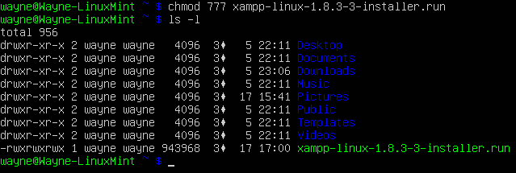
Install XAMPP
Endow Executable properties:
Original: (-rw-r--r--)
Endow the properties: (-rwxrwxrwx):

Slide 7
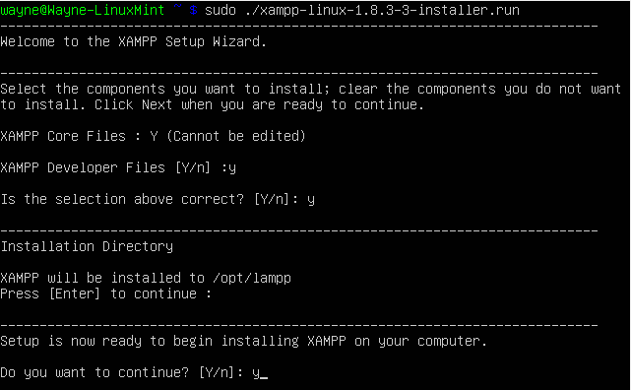
Install XAMPP
Execute the file as ROOT:

Slide 8
Install XAMPP
Install Finished:

Slide 9
Configure XAMPP
Does not bring up at startup by default:
Suitable for Beginners
Keep Beginners Server Secure
If needed , refer the rc.conf
Default directory of XAMPP:
/opt/lampp
Start or stop XAMPP (ROOT Previlege):
/opt/lampp/xampp start
/opt/lampp/xampp stop

Slide 10
Configure XAMPP
Example of XAMPP Start

Slide 11
Login into phpmyadmin
Start X Windows
Run Firefox
Refer to your X Windows Instruction
Terminal type “firefox” to execute.
Go to http://localhost/
No firefox:
Debian Based: apt-get install firefox
Other refer the man page to install firefox

Slide 12
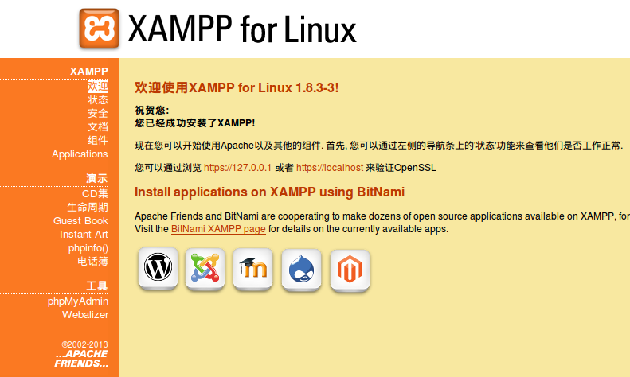
Login into phpmyadmin
If Successful, you will see the webpage:

Slide 13
Login into phpmyadmin
On the left, at the part of ‘Tools’click phpmyadmin

Slide 14
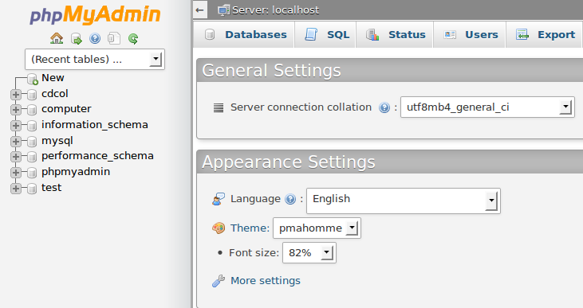
Login into phpmyadmin
If Successful, you will see the webpage:

Slide 15
Project: A computer store database
Including all information of a computer
Similar the cases as the same as the customer require
Correct errors, ether the datatype or data in Database.
Delete the record when computer was sold out.

Slide 16
Create Databases

Slide 17
Create Database
We can see by the sidebar as it was created.

Slide 18
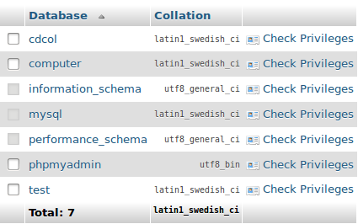
Create Database
But some small problems occurred:

Slide 19
Create Database
What happened with Latin1?:
Does not support Non-Latin Words:
That also means can’t store Chinese character
Some of the Computer Brands or Model are Chinese:
清華同方 超瑞X200
Too much Non-Latins accidentally stored will crash MySQL

Slide 20
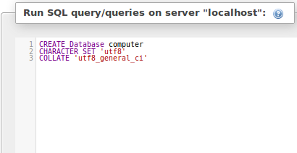
Create Database
Change encoding options as UTF-8:

Slide 21
Create Database
Why UTF-8?
It is widely used on the world.
Most of the computer support this encoding method
Non-Latin words such as Chinese can be stored.

Slide 22
Create Database
Corrected Database:

Slide 23
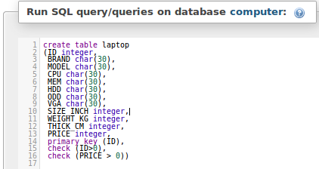
Create Tables
Create a Table: Laptop, containing all info. Of Laptops

Slide 24
Create Tables
Successfully Created:

Slide 25
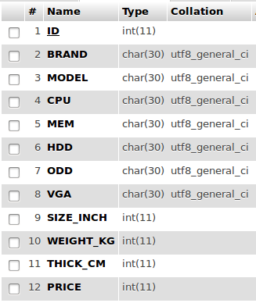
Create Tables
Structures:

Slide 26
Inserting Datas
Inserting 3 Laptops Data:

Slide 27
Inserting Datas
We expect the result as:
But:
Why?

Slide 28
Correcting Structure Error
Because the Database we create:
They are integers, not float

Slide 29
Correcting Structure Error
No Need to Delete, Correct them
Use: ALTER TABLE * MODIFY * [DATATYPE]

Slide 30
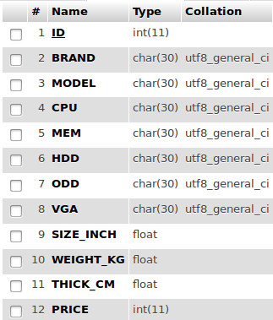
Correcting Structure Error
Changed to float:

Slide 31
Correcting Datas:
But Still:
WHY?

Slide 32
Correcting Datas
it is only ‘integer’allowed
Some was lost once the data was stored during that time.
We need to update Datas by ourselves again.

Slide 33
Correcting Datas
Using Update to Correct:

Slide 34
Correcting Datas
After several updates:
Correct Result

Slide 35
Situation – Customers Request
A Customer Request for computers under 20000NT$
Resort Gives out:

Slide 36
Situation – Customers Request
A Customer Request for any Computers bigger than 13 Inches
Also, He does not need too detail of computer specification
Result:

Slide 37
Situation – Sold
When a item was sold, it must be removed from database:
Aspire V3-551G was sold:
Result:

Slide 38
Thoughts:
Linux is a ultra-flexible platform, but somehow complex
I recommend XAMPP to beginners because to setup such environment on Linux is a lot of hassle and sometimes need patients to troubleshooting.

Slide 39
Thank you for appreciate your time

